Slide 1
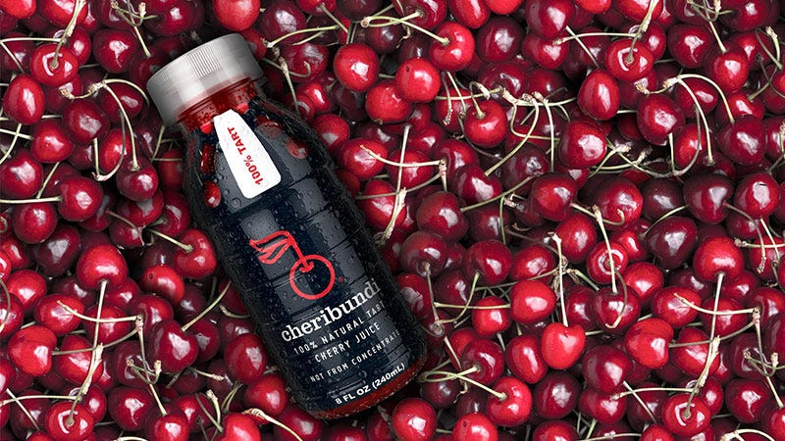
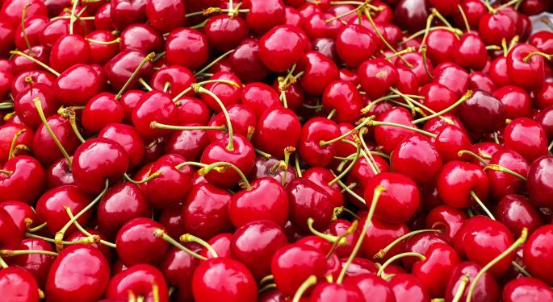
Benefits of consuming
Cherries
Sweet cherries are dark red or purple and are a delicious treat.
Tart cherries are bright red and usually used for cooking or making juice.
For more information, visit our website:
www.advancedhealth.com/healthy-bytes-initiative

Slide 2
Benefits of consuming
Benefits of consuming
Millet
Cherries
1 cup raw, pitted cherries provides:
87 Calories
2 gm protein
3 gm fiber
No fat
No cholesterol
For more information, visit our website:
www.advancedhealth.com/healthy-bytes-initiative

Slide 3
Benefits of consuming
Cherries
Cherries are an excellent source of antioxidants vitamin C,
vitamin A (beta-carotene) polyphenols and anthocyanins
to protect against aging and disease.
For more information, visit our website:
www.advancedhealth.com/healthy-bytes-initiative

Slide 4
Benefits of consuming
Cherries
Good source of vitamin K, folate and potassium
which lowers blood pressure and supports heart health.
For more information, visit our website:
www.advancedhealth.com/healthy-bytes-initiative

Slide 5
Benefits of consuming
Cherries
Contain phytosterols, known to help lower cholesterol and triglycerides,
and melatonin, which may help you sleep.
For more information, visit our website:
www.advancedhealth.com/healthy-bytes-initiative

Slide 6
Benefits of consuming
Cherries
Fiber in cherries feeds healthy microbiome
and helps you feel full, which helps with weight management.
For more information, visit our website:
www.advancedhealth.com/healthy-bytes-initiative

Slide 7
Benefits of consuming
Cherries
One to 2 cups of tart cherry juice per day has been shown to lower inflammation, cholesterol, blood pressure and improve sleep.
For more information, visit our website:
www.advancedhealth.com/healthy-bytes-initiative

Slide 8
Benefits of consuming
Cherries
Chop fresh or dried cherries into salads, veggie side dishes or oatmeal.
Blend frozen cherries or tart cherry juice in smoothies.
For more information, visit our website:
www.advancedhealth.com/healthy-bytes-initiative

