Slide 1
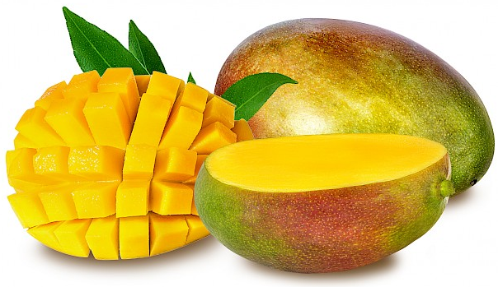
Benefits of consuming
Mangos
This tropical fruit is refreshing and nutritious, with a sweet, creamy texture
and a bold sweetness, earning it the title, “King of Fruits.”
For more information, visit our website:
www.advancedhealth.com/healthy-bytes-initiative

Slide 2
Benefits of consuming
Benefits of consuming
Mangos
Millet
1 cup raw, cubed mango provides:
99 Calories
1.4 gm protein
3 gm fiber
0.4 gm fat
No cholesterol
For more information, visit our website:
www.advancedhealth.com/healthy-bytes-initiative

Slide 3
Benefits of consuming
Mangos
Mangos are an excellent source of antioxidants vitamin C, E and several
varieties of carotenoids (beta-carotene, lutein, quercetin, ellagic acid)
that boost immune function and protect against aging and disease.
For more information, visit our website:
www.advancedhealth.com/healthy-bytes-initiative

Slide 4
Benefits of consuming
Mangos
Contains B vitamins for metabolism;
B6, potassium and magnesium lower homocysteine and blood pressure
for heart health.
For more information, visit our website:
www.advancedhealth.com/healthy-bytes-initiative

Slide 5
Benefits of consuming
Mangos
Rich in prebiotic and soluble fiber
which helps control blood sugars and lower cholesterol.
For more information, visit our website:
www.advancedhealth.com/healthy-bytes-initiative

Slide 6
Benefits of consuming
Mangos
The peel is edible and contains carotenoids, fiber, vitamin E
and small amounts of omega-3 fatty acids.
For more information, visit our website:
www.advancedhealth.com/healthy-bytes-initiative

Slide 7
Benefits of consuming
Mangos
Enjoy sliced, pureed or dried for a sweet healthy treat.
Toss on salads, in smoothies, or dehydrate into fruit leather.
For more information, visit our website:
www.advancedhealth.com/healthy-bytes-initiative

