Slide 1
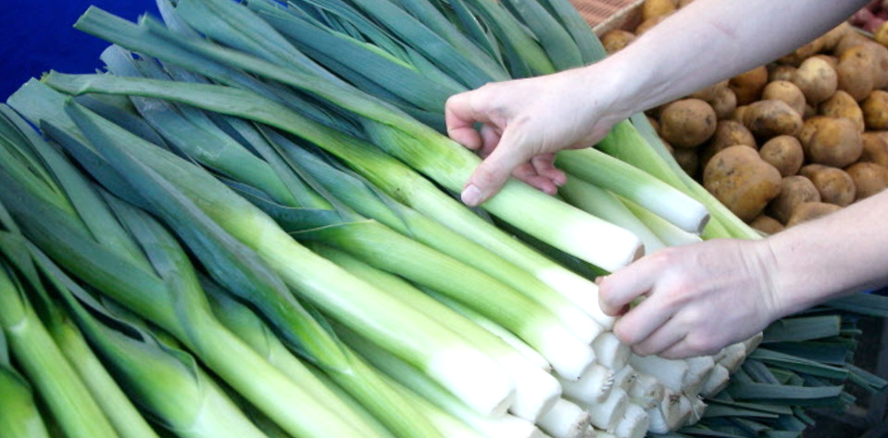


Benefits of consuming
Leeks
Leeks are a member of the allium family which also includes
onions and garlic. Leeks look similar to green onions but larger, up to
a foot long with a 1-2 inch diameter. They have a mild, sweet onion flavor.
For more information, visit our website:
www.advancedhealth.com/healthy-bytes-initiative

Slide 2
Benefits of consuming
Benefits of consuming
Millet
Leeks
1 cup raw or ½ cup cooked leeks provides:
54 Calories
1 gm protein
2 gm fiber
No fat
No cholesterol
For more information, visit our website:
www.advancedhealth.com/healthy-bytes-initiative

Slide 3
Benefits of consuming
Leeks
Excellent source of antioxidants like vitamins C, K and beta-carotene
with anti-inflammatory, anti-aging and cardiovascular benefits.
Gallic acid in leeks also helps to reduce inflammation.
For more information, visit our website:
www.advancedhealth.com/healthy-bytes-initiative

Slide 4
Benefits of consuming
Leeks
Quercetin in leeks is associated with lowering blood pressure
and risk of dementia like Alzheimer’s and Parkinson’s disease
For more information, visit our website:
www.advancedhealth.com/healthy-bytes-initiative

Slide 5
Benefits of consuming
Leeks
Kaempferol is a compound in leeks that helps produce nitric oxide,
a vasodilator that widens arteries and improves blood circulation.
For more information, visit our website:
www.advancedhealth.com/healthy-bytes-initiative

Slide 6
Benefits of consuming
Benefits of consuming
Leeks
Lentils
Folate and B6 work to keep homocysteine low,
preventing artery damage and reducing formation of blood clots.
For more information, visit our website:
www.advancedhealth.com/healthy-bytes-initiative

Slide 7
Benefits of consuming
Leeks
Like other allium vegetables (garlic, onions),
chop leeks and let them rest 5 minutes before cooking.
This helps to retain nutrients.
For more information, visit our website:
www.advancedhealth.com/healthy-bytes-initiative

