Slide 1
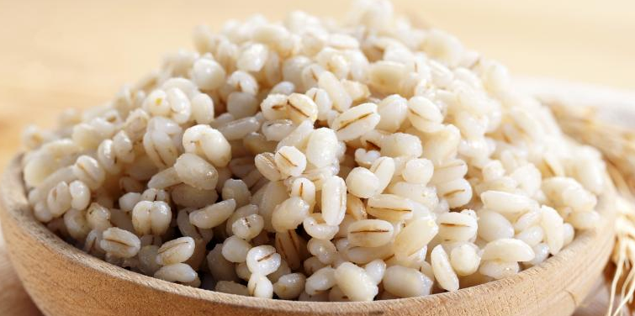


Benefits of consuming
Barley
Barley, like oats, is a chewy grain with cholesterol-lowering effects.
Hulled barley is considered whole grain. Pearled barley,
the kind most often found in grocery stores, is refined but still nutritious.
For more information, visit our website:
www.advancedhealth.com/healthy-bytes-initiative

Slide 2
Benefits of consuming
Benefits of consuming
Barley
Millet
½ cup cooked pearled barley provides:
176 Calories
5 gm protein
8 gm fiber
No fat
No cholesterol
For more information, visit our website:
www.advancedhealth.com/healthy-bytes-initiative

Slide 3
Benefits of consuming
Barley
Excellent source of potassium which helps moderate blood pressure, magnesium important for nerve function and energy production,
and calcium and phosphorus for strong bones.
For more information, visit our website:
www.advancedhealth.com/healthy-bytes-initiative

Slide 4
Benefits of consuming
Barley
Barley is a rich source of B vitamins like niacin, thiamin, folate and B6,
and the antioxidant selenium.
For more information, visit our website:
www.advancedhealth.com/healthy-bytes-initiative

Slide 5
Benefits of consuming
Barley
Soak hulled barley, drain and rinse before cooking in water or broth.
Pearled barley does not require pre-soaking.
For more information, visit our website:
www.advancedhealth.com/healthy-bytes-initiative

Slide 6
Benefits of consuming
Benefits of consuming
Barley
Lentils
Toss barley into soups or stews. Mix cooked barley into veggie sides.
Use barley instead of rice or pasta in casseroles or burritos.
For more information, visit our website:
www.advancedhealth.com/healthy-bytes-initiative

