Slide 1
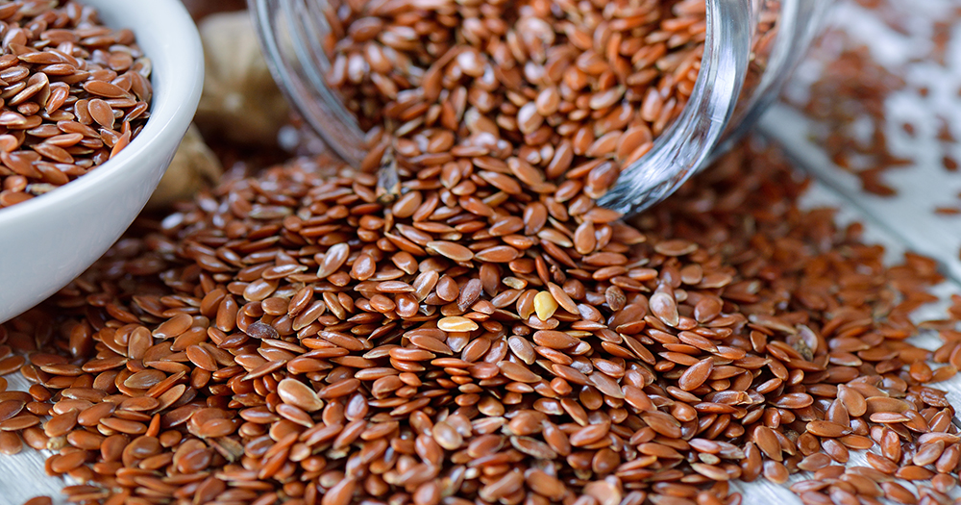


Benefits of consuming
Flax Seeds
Flax seeds, also called flaxseeds or linseeds, are best consumed ground,
which releases the nutrition within.
They are a good source of protein, lignans, omega-3 fats and fiber.
For more information, visit our website:
www.advancedhealth.com/healthy-bytes-initiative

Slide 2
Benefits of consuming
Benefits of consuming
Millet
Flax Seeds
2 Tbsp (per day) ground flaxseed provides:
70 Calories
33 gm protein
3 gm fiber
4.5 gm fat
No cholesterol
For more information, visit our website:
www.advancedhealth.com/healthy-bytes-initiative

Slide 3
Benefits of consuming
Flax Seeds
Ground flaxseeds is a good source of soluble fiber that helps
lower cholesterol, maintain steady blood sugars
and promote feelings of fullness for weight management.
For more information, visit our website:
www.advancedhealth.com/healthy-bytes-initiative

Slide 4
Benefits of consuming
Flax Seeds
Flaxseeds contain compounds our body converts to lignans,
plant estrogens shown to reduce risk of cancer,
osteoporosis and heart disease.
For more information, visit our website:
www.advancedhealth.com/healthy-bytes-initiative

Slide 5
Benefits of consuming
Flax Seeds
Flaxseeds are rich in the essential omega-3 fatty acid, alpha linoleic acid (ALA)with anti-inflammatory properties associated with lowering risk of heart disease, stroke, autoimmune disease and depression.
For more information, visit our website:
www.advancedhealth.com/healthy-bytes-initiative

Slide 6
Benefits of consuming
Benefits of consuming
Flax Seeds
Lentils
Flaxseeds also contain B vitamins, manganese, magnesium,
phosphorus, calcium, iron and potassium.
For more information, visit our website:
www.advancedhealth.com/healthy-bytes-initiative

Slide 7
Benefits of consuming
Flax Seeds
With a nutty flavor, ground flaxseed is delicious sprinkled in oatmeal,
on salads or in baked goods.
1 Tbsp flax meal + 3 Tbsp water = 1 egg replacement
For more information, visit our website:
www.advancedhealth.com/healthy-bytes-initiative

