Slide 1
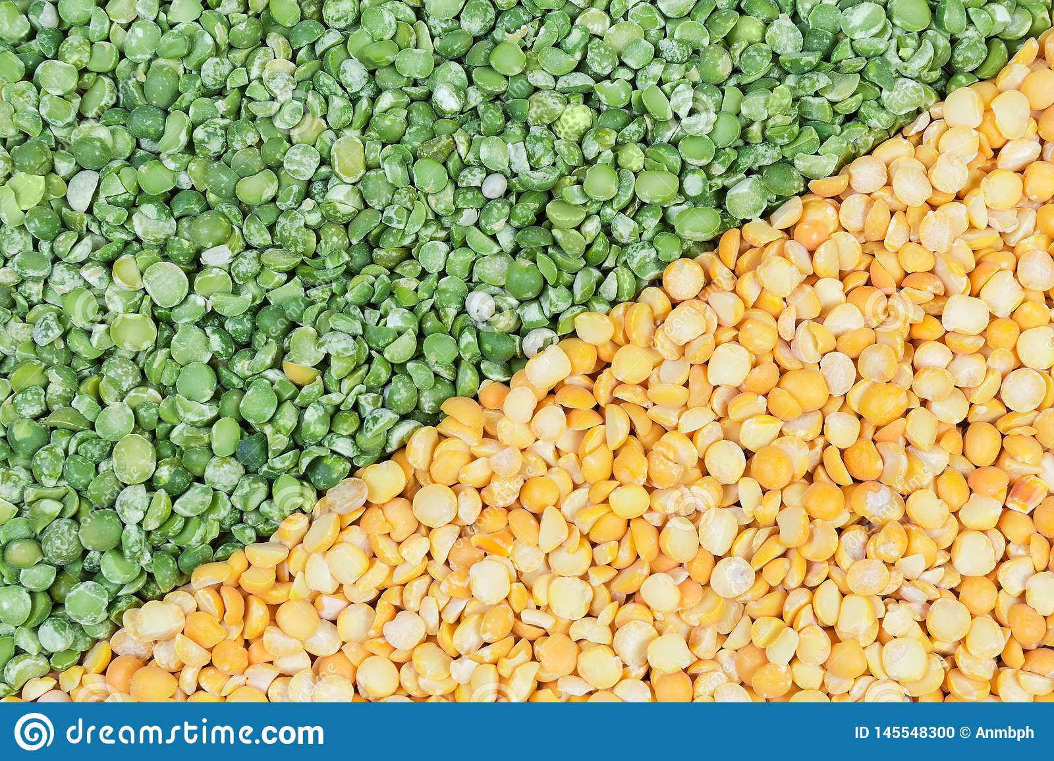


Benefits of consuming
Split Peas
Rich in protein, split peas are a high-fiber, low-Calorie alternative to meat. Simple substitutions can help prevent heart disease, diabetes,
osteoporosis, inflammation and some forms of cancer.
For more information, visit our website:
www.advancedhealth.com/healthy-bytes-initiative

Slide 2
Benefits of consuming
Benefits of consuming
Millet
Split Peas
½ cup of cooked split peas provides:
116 Calories
8 gm protein
8 gm fiber
No fat
No cholesterol
For more information, visit our website:
www.advancedhealth.com/healthy-bytes-initiative

Slide 3
Benefits of consuming
Split Peas
Excellent source of molybdenum, a trace element involved in
digesting proteins, making DNA and metabolizing chemical toxins,
especially sulfite preservatives.
For more information, visit our website:
www.advancedhealth.com/healthy-bytes-initiative

Slide 4
Benefits of consuming
Split Peas
Split peas are a very good source of fiber that helps
lower cholesterol, maintain steady blood sugars
and prevent constipation and hemorrhoids.
For more information, visit our website:
www.advancedhealth.com/healthy-bytes-initiative

Slide 5
Benefits of consuming
Split Peas
Split peas are rich in B vitamins thiamin, pantothenic acid and folate.
They contain essential minerals copper, manganese and phosphorus.
For more information, visit our website:
www.advancedhealth.com/healthy-bytes-initiative

Slide 6
Benefits of consuming
Benefits of consuming
Split Peas
Lentils
Split peas are a source of isoflavones
that protect against breast and prostate cancer.
For more information, visit our website:
www.advancedhealth.com/healthy-bytes-initiative

Slide 7
Benefits of consuming
Split Peas
Use split peas in soups and stews, or as a side dish. Puree for use in sauces for casseroles or with herbs as a vegetable or cracker dip.
Try making crunchy split peas as an afterschool snack or dessert topping.
For more information, visit our website:
www.advancedhealth.com/healthy-bytes-initiative

