Slide 1
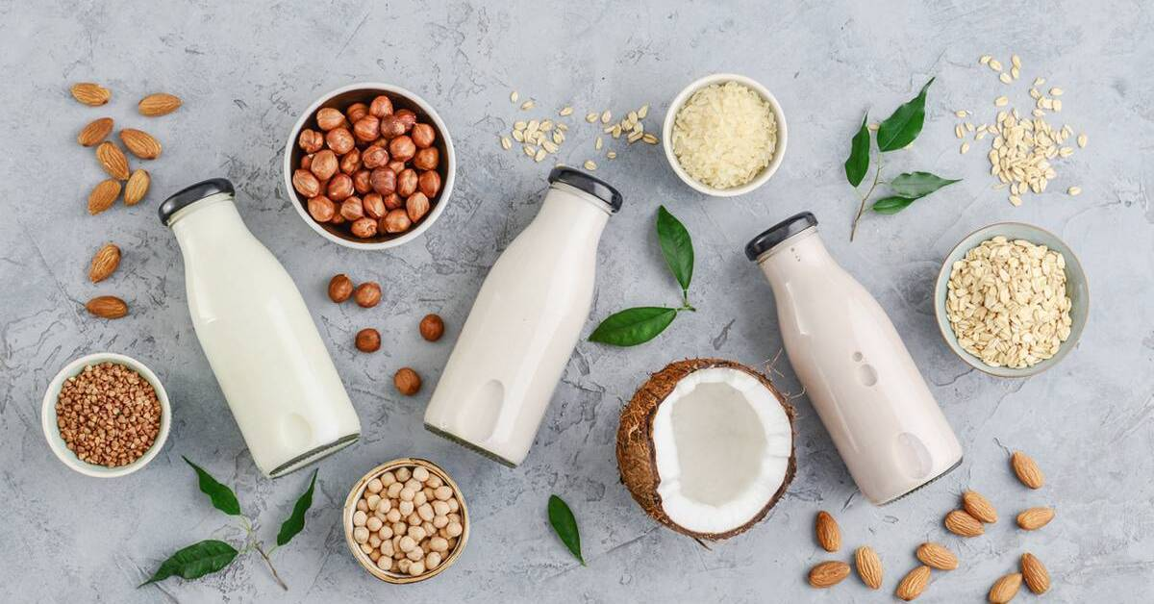


Benefits of consuming
Non-Dairy Milks
Dairy-alternative milks have less fat and fewer Calories than animal dairy and contain no cholesterol, lowering risk for heart disease.
For more information, visit our website:
www.advancedhealth.com/healthy-bytes-initiative

Slide 2
Benefits of consuming
Non-Dairy Milks
Non-dairy milks can reduce inflammation, lower insulin levels and can decrease risk for estrogen-sensitive cancers.
They do not contain hormones or antibiotics but buy organic when possible.
For more information, visit our website:
www.advancedhealth.com/healthy-bytes-initiative

Slide 3
Benefits of consuming
Non-Dairy Milks
Less likely to be allergenic and contain no lactose.
Non-dairy milks are easy to digest.
For more information, visit our website:
www.advancedhealth.com/healthy-bytes-initiative

Slide 4
Benefits of consuming
Non-Dairy Milks
Grain milks contain vitamin E and polyphenol antioxidants.
Soy milk contains higher protein and isoflavones that fight cancer.
For more information, visit our website:
www.advancedhealth.com/healthy-bytes-initiative

Slide 5
Benefits of consuming
Benefits of consuming
Split Peas
Non-Dairy Milks
Soy, oat and hemp milks have more protein compared to rice, almond and coconut milks.
For more information, visit our website:
www.advancedhealth.com/healthy-bytes-initiative

Slide 6
Benefits of consuming
Non-Dairy Milks
Benefits of consuming
Millet
Milk (1 cup) | Cal | Fat | Pro | Pro/Con
Cow (whole) | 150 | 8 | 8 | Calcium, cholesterol, allergy and intolerances
Soy (unsweetened) | 80 | 4 | 7 | Potassium, isoflavones
Hemp (unsweetened) | 83 | 7 | 5 | Zero carbohydrates
Oat (naturally sweet) | 120 | 5 | 3 | Naturally sweet
Almond (unsweetened) | 40 | 3 | 2 | More calcium than cow’s
Coconut (unsweetened) | 50 | 5 | 0 | Flavorful, buy low-fat
Rice (unsweetened) | 120 | 2 | 0 | Least likely to be allergenic, may contain arsenic
For more information, visit our website:
www.advancedhealth.com/healthy-bytes-initiative

Slide 7
Benefits of consuming
Benefits of consuming
Lentils
Non-Dairy Milks
Read ingredient labels and select brands that do not contain carrageenan (thickener) or added sweeteners.
For more information, visit our website:
www.advancedhealth.com/healthy-bytes-initiative

Slide 8
Benefits of consuming
Non-Dairy Milks
These milks are budget friendly and can easily be made at home
with water and a high-speed blender.
They can be used 1:1 in recipes.
For more information, visit our website:
www.advancedhealth.com/healthy-bytes-initiative

