Slide 1
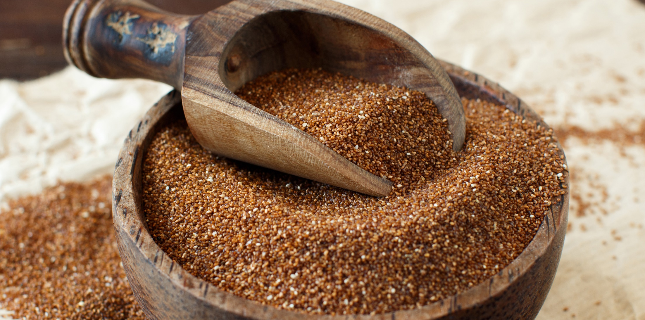


Benefits of consuming
Teff
Teff is the world’s smallest grain with big nutrition.
High in protein, iron and fiber, this grain is gluten-free
and has a rich, nutty flavor.
For more information, visit our website:
www.advancedhealth.com/healthy-bytes-initiative

Slide 2
Benefits of consuming
Benefits of consuming
Millet
Teff
1 cup cooked teff provides:
255 Calories
10 gm protein
8 gm fiber
2 gm fat
No cholesterol
For more information, visit our website:
www.advancedhealth.com/healthy-bytes-initiative

Slide 3
Benefits of consuming
Teff
1 cup of cooked teff provides 29% of the daily iron requirement.
It is rich in B vitamins, thiamine, folate and B6.
For more information, visit our website:
www.advancedhealth.com/healthy-bytes-initiative

Slide 4
Benefits of consuming
Teff
Teff provides magnesium and potassium for heart health,
manganese for blood sugar control and
zinc and vitamin C for healing.
For more information, visit our website:
www.advancedhealth.com/healthy-bytes-initiative

Slide 5
Benefits of consuming
Teff
Teff contains calcium for strong bones and healthy teeth.
For more information, visit our website:
www.advancedhealth.com/healthy-bytes-initiative

Slide 6
Benefits of consuming
Benefits of consuming
Teff
Lentils
Teff cooks quickly and makes a nutritious breakfast porridge or side dish.
For more information, visit our website:
www.advancedhealth.com/healthy-bytes-initiative

Slide 7
Benefits of consuming
Teff
As an intact grain, teff has a low glycemic index,
making it a good choice for those with diabetes.
Once ground into flour, the glycemic index goes up.
For more information, visit our website:
www.advancedhealth.com/healthy-bytes-initiative

Slide 8
Benefits of consuming
Teff
Ground teff flour can be substitute for 50% of the wheat flour
in baked goods. Being gluten-free, teff flour adds flavor and texture.
For more information, visit our website:
www.advancedhealth.com/healthy-bytes-initiative

Slide 9
Benefits of consuming
Teff
Store teff in refrigerator or freezer until ready to use.
Because it is an intact grain, it will last up to a year.
Once cooked, finish your teff within 5 days.
For more information, visit our website:
www.advancedhealth.com/healthy-bytes-initiative

