Slide 1
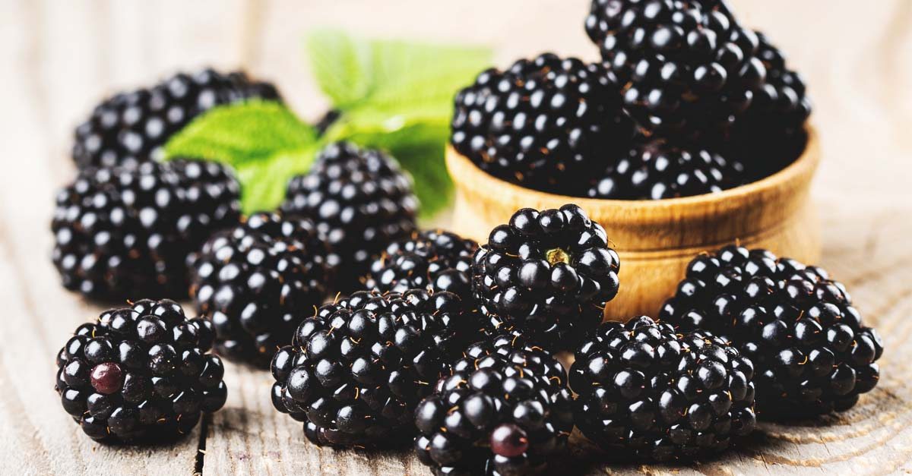


Benefits of consuming
Blackberries
A tangy, nutrient-dense fruit, blackberries are loaded with powerful antioxidants and their seeds are rich in essential oils.
Note blackberries are a different fruit than black raspberries.
For more information, visit our website:
www.advancedhealth.com/healthy-bytes-initiative

Slide 2


Benefits of consuming
Blackberries
Blackberry:
stem stays in the fruit center
Black raspberry:
stem is pulled from fruit leaving a hollow inside
For more information, visit our website:
www.advancedhealth.com/healthy-bytes-initiative

Slide 3
Benefits of consuming
Benefits of consuming
Millet
Blackberries
1 cup whole, fresh blackberries provides:
62 Calories
2 gm protein
8 gm fiber
0.7 gm fat
No cholesterol
For more information, visit our website:
www.advancedhealth.com/healthy-bytes-initiative

Slide 4
Benefits of consuming
Blackberries
Contain antioxidants vitamins C, E and K, polyphenols, flavonoids, anthocyanins, carotenoids, salicylic acid and ellagic acid
giving them top scores for protection from aging and disease.
For more information, visit our website:
www.advancedhealth.com/healthy-bytes-initiative

Slide 5
Benefits of consuming
Blackberries
Blackberry seeds are a source of
essential omega 3 and omega 6 fatty acids.
For more information, visit our website:
www.advancedhealth.com/healthy-bytes-initiative

Slide 6
Benefits of consuming
Blackberries
Contain B vitamins thiamin, niacin, riboflavin, folate
and minerals calcium, iron, magnesium, phosphorous, potassium and zinc.
The are also high in fiber.
For more information, visit our website:
www.advancedhealth.com/healthy-bytes-initiative

Slide 7
Benefits of consuming
Benefits of consuming
Lentils
Blackberries
Rich in nutrients that protect against heart disease and cancer,
prevent bone loss and boost immunity and brain function.
For more information, visit our website:
www.advancedhealth.com/healthy-bytes-initiative

Slide 8
Benefits of consuming
Blackberries
Select fresh blackberries with a deep, dark color
and consume withing 3-4 days or freeze.
For more information, visit our website:
www.advancedhealth.com/healthy-bytes-initiative

