Slide 1
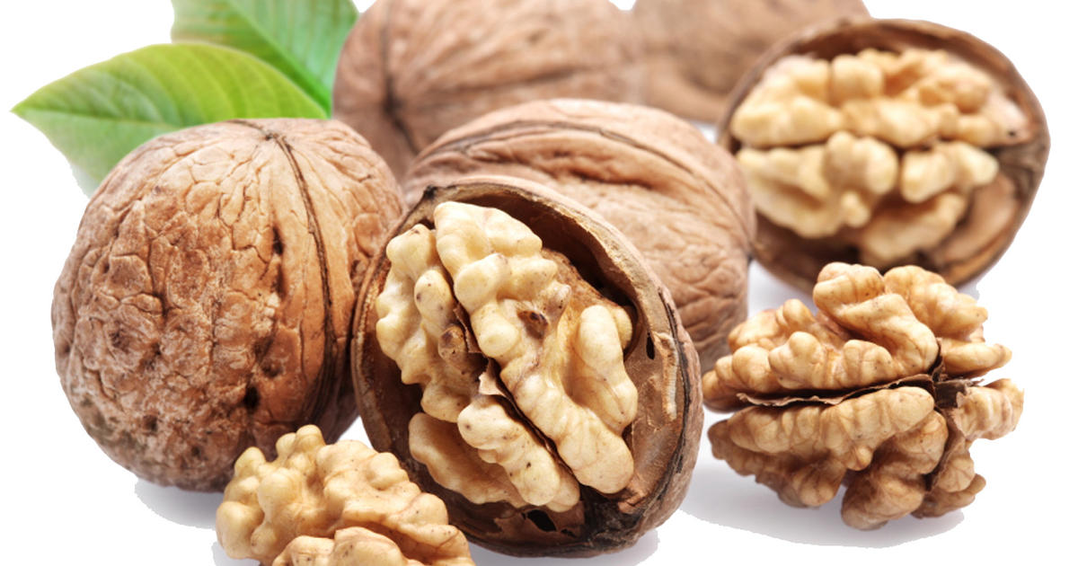
Benefits of consuming
Walnuts
Walnuts, and other tree nuts like almonds and pecans, are rich in
vitamins, minerals, healthy oils and fiber. They have been shown to
lower cholesterol and inflammation, decreasing risk of heart disease.
For more information, visit our website:
www.advancedhealth.com/healthy-bytes-initiative

Slide 2
Benefits of consuming
Benefits of consuming
Millet
Walnuts
1 oz raw walnuts provides:
183 Calories
4 gm protein
3 gm fiber
18 gm fat
No cholesterol
For more information, visit our website:
www.advancedhealth.com/healthy-bytes-initiative

Slide 3
Benefits of consuming
Walnuts
Walnuts have more healthy omega 3 fats
than any other plant food.
For more information, visit our website:
www.advancedhealth.com/healthy-bytes-initiative

Slide 4
Benefits of consuming
Walnuts
Phytosterols in walnuts are good for your heart.
They can lower LDL cholesterol, total cholesterol and triglycerides.
For more information, visit our website:
www.advancedhealth.com/healthy-bytes-initiative

Slide 5
Benefits of consuming
Walnuts
The amino acid, L-Arginine, in walnuts helps make nitric oxide,
a vasodilator that lowers blood pressure,
improves blood flow and circulation.
For more information, visit our website:
www.advancedhealth.com/healthy-bytes-initiative

Slide 6
Benefits of consuming
Benefits of consuming
Walnuts
Lentils
Vitamin E’s antioxidant capacity protects against free radicals, helps
heal artery walls and boost immunity.
For more information, visit our website:
www.advancedhealth.com/healthy-bytes-initiative

Slide 7
Benefits of consuming
Walnuts
Toss on salads, in muffin batter
or grind with beans in hummus or veggie dips.
Puree in a high-speed blender to make walnut butter for toast.
For more information, visit our website:
www.advancedhealth.com/healthy-bytes-initiative

