Slide 1
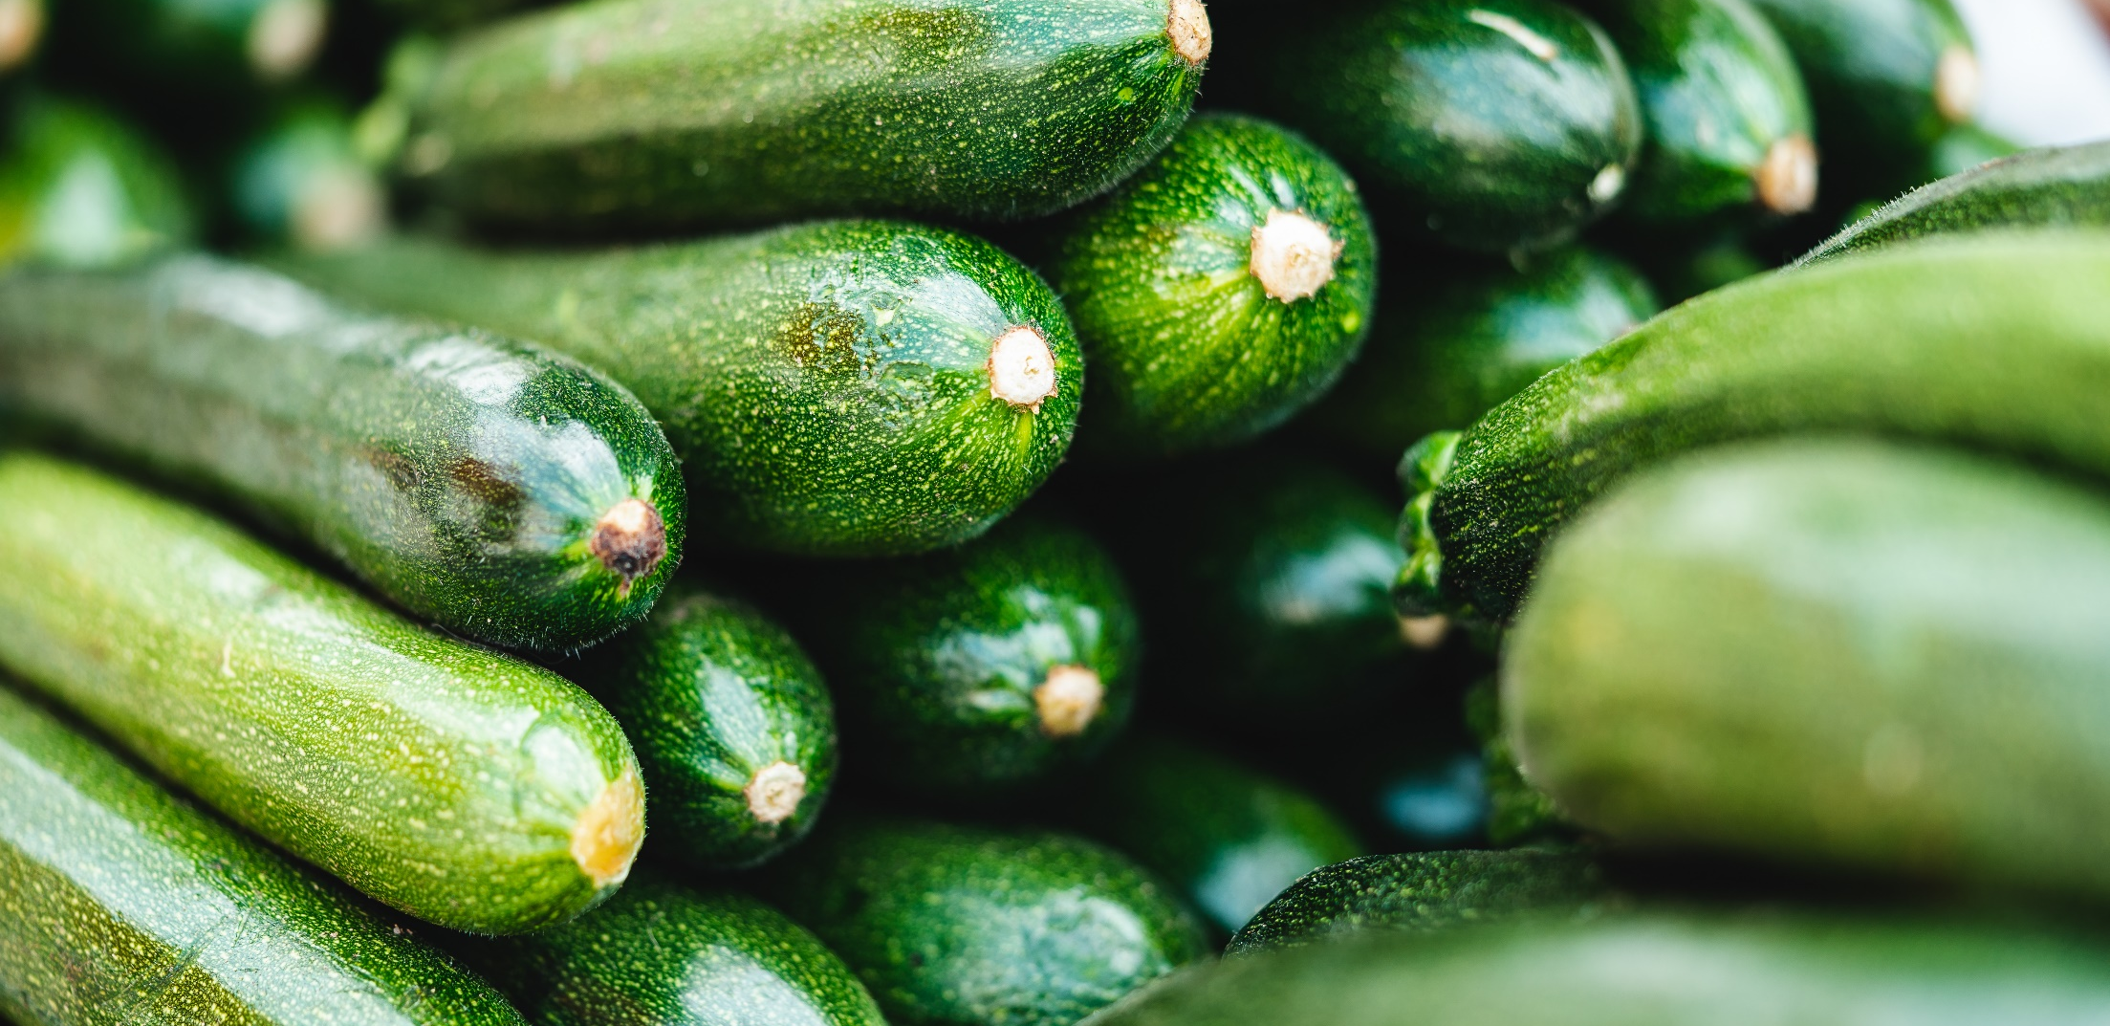
Benefits of consuming
Zucchini
A summer squash, zucchini skins range from yellow to dark green.
Rich in antioxidants, vitamins, minerals and fiber, they are low in calories.
Insides, skins and seeds are all edible.
For more information, visit our website:
www.advancedhealth.com/healthy-bytes-initiative

Slide 2
Benefits of consuming
Benefits of consuming
Millet
Zucchini
1 cup chopped, raw zucchini provides:
20 Calories
1 gm protein
1 gm fiber
0.2 gm fat
No cholesterol
For more information, visit our website:
www.advancedhealth.com/healthy-bytes-initiative

Slide 3
Benefits of consuming
Zucchini
Zucchini contains antioxidant zeaxanthin and lutein,
which promote eye health by reducing risk of eye conditions
cataracts and glaucoma.
For more information, visit our website:
www.advancedhealth.com/healthy-bytes-initiative

Slide 4
Benefits of consuming
Zucchini
Zucchini squash is rich in B vitamins
thiamin, riboflavin, niacin and B6.
For more information, visit our website:
www.advancedhealth.com/healthy-bytes-initiative

Slide 5
Benefits of consuming
Benefits of consuming
Lentils
Zucchini
Zucchini contain minerals potassium, magnesium, calcium
and phosphorus that help maintain normal blood pressure,
regulate fluids and boost energy production.
For more information, visit our website:
www.advancedhealth.com/healthy-bytes-initiative

Slide 6
Benefits of consuming
Zucchini
Zucchini can be sliced, cubed or shredded and eaten raw with dips,
in salads or sliced on sandwiches.
For more information, visit our website:
www.advancedhealth.com/healthy-bytes-initiative

Slide 7
Benefits of consuming
Zucchini
Cooked zucchini is great in stir fry, soups
or spiralized into noodles called zoodles.
For more information, visit our website:
www.advancedhealth.com/healthy-bytes-initiative

Slide 8
Benefits of consuming
Zucchini
Raw uncut zucchini will stay fresh for 2 weeks
when stored in a perforated bag in the refrigerator.
Once cut, use within 2-4 days.
For more information, visit our website:
www.advancedhealth.com/healthy-bytes-initiative

