Slide 1
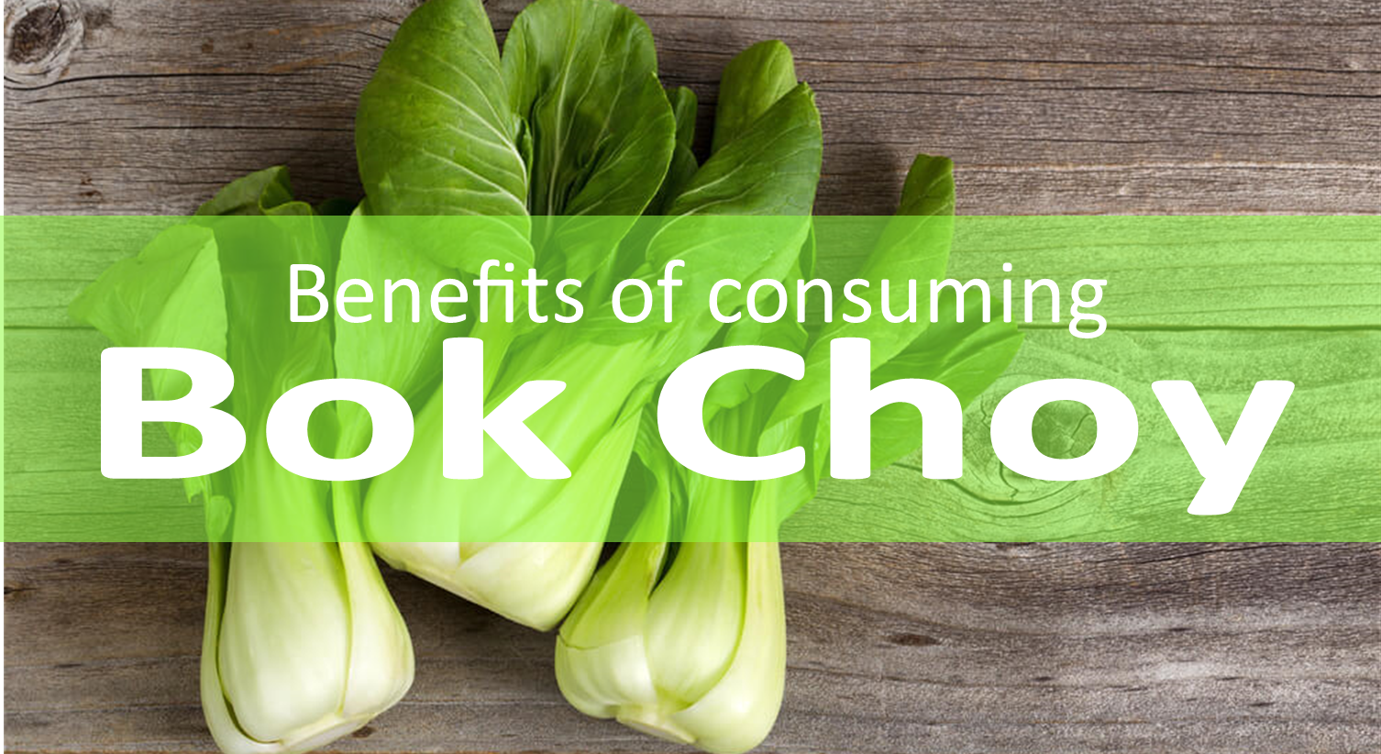


Bok choy is a type of Chinese cabbage that can help
build strong bones, improve blood circulation and
provide compounds that can prevent chronic disease.
For more information, visit our website:
www.advancedhealth.com/healthy-bytes-initiative

Slide 2
1 cup raw or ½ cup cooked Bok choy provides:
9 Calories
1 gm protein
1 gm fiber
0.1 gm fat
No cholesterol
For more information, visit our website:
www.advancedhealth.com/healthy-bytes-initiative

Slide 3
Powerful antioxidants and flavonoids lutein, beta-carotene, vitamin C, quercetin and many more fight free radicals
and reduce inflammation to prevent chronic disease.
For more information, visit our website:
www.advancedhealth.com/healthy-bytes-initiative

Slide 4
Bok Choy contains calcium, zinc, iron, and magnesium that improve bone density and prevent osteoporosis.
For more information, visit our website:
www.advancedhealth.com/healthy-bytes-initiative

Slide 5
Bok choy contains folate and vitamin B6 to prevent anemia and birth defects.
For more information, visit our website:
www.advancedhealth.com/healthy-bytes-initiative

Slide 6
Like other cruciferous vegetables, Bok choy
contains compounds, mostly in the stalks,
which may reduce risk of cancer and tumor growth.
For more information, visit our website:
www.advancedhealth.com/healthy-bytes-initiative

Slide 7
Choose fresh bunches with firm stalks and crisp leaves.
Wash dirt from between the leaves.
For more information, visit our website:
www.advancedhealth.com/healthy-bytes-initiative

Slide 8
Shred raw Bok choy for salads.
Chop into stir fry, grill, stem or toss in soups or stews.
For more information, visit our website:
www.advancedhealth.com/healthy-bytes-initiative

Slide 9
Bok choy cooks quickly within 5-10 minutes depending on the recipe and have a light refreshing taste. Overcooked Bok choy can become mushy.
For more information, visit our website:
www.advancedhealth.com/healthy-bytes-initiative

