Slide 1
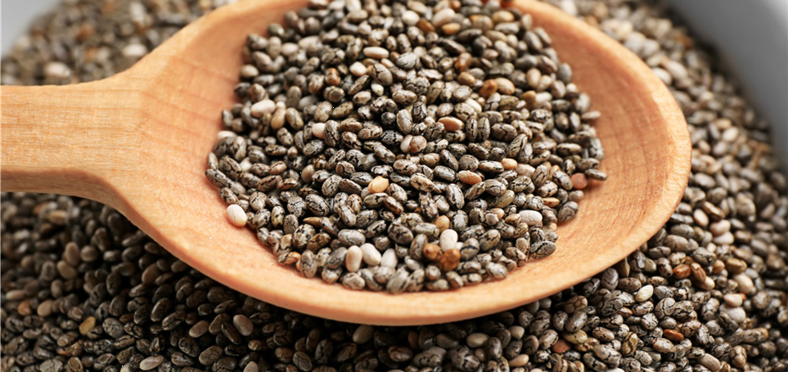


Benefits of consuming
Chia Seeds
Chia seeds are rich in protein, omega-3 fats and soluble fiber
which contribute to lowering risk for heart disease,
diabetes and obesity.
For more information, visit our website:
www.advancedhealth.com/healthy-bytes-initiative

Slide 2
Benefits of consuming
Chia Seeds
2 Tbsp chia seed provides:
140 Calories
4 gm protein
11 gm fiber
7 gm fat
No cholesterol
For more information, visit our website:
www.advancedhealth.com/healthy-bytes-initiative

Slide 3
Benefits of consuming
Chia Seeds
Chia seeds are the richest source of omega-3 fats shown to
lower cholesterol, blood pressure, inflammation
and risk of heart attack and stroke.
For more information, visit our website:
www.advancedhealth.com/healthy-bytes-initiative

Slide 4
Benefits of consuming
Chia Seeds
These are an excellent source of soluble fiber
which stabilizes blood sugars, lowers cholesterol
and aids in appetite control.
For more information, visit our website:
www.advancedhealth.com/healthy-bytes-initiative

Slide 5
Benefits of consuming
Chia Seeds
Chia seeds contain more calcium and magnesium than milk
for bone and heart health. They are also a rich source of potassium
which lowers blood pressure.
For more information, visit our website:
www.advancedhealth.com/healthy-bytes-initiative

Slide 6
Benefits of consuming
Chia Seeds
These small seeds contain all 9 essential amino acids
for building protein.
For more information, visit our website:
www.advancedhealth.com/healthy-bytes-initiative

Slide 7
Benefits of consuming
Chia Seeds
Chia is rich in antioxidants shown to lower inflammation,
improve immunity and protect brain function.
For more information, visit our website:
www.advancedhealth.com/healthy-bytes-initiative

Slide 8
Benefits of consuming
Chia Seeds
Use chia seeds whole, no need to grind.
Sprinkle in salads, toss with veggie sides, in baked goods,
smoothies, puddings and jams.
For more information, visit our website:
www.advancedhealth.com/healthy-bytes-initiative

Slide 9
Benefits of consuming
Chia Seeds
Use chia seeds as base for creamy dressings or as an egg substitute.
Stir 1 Tbsp chia seeds into 3 Tbsp water for each egg in a recipe.
These egg substitutes have no saturated fat or cholesterol.
For more information, visit our website:
www.advancedhealth.com/healthy-bytes-initiative

