Slide 1
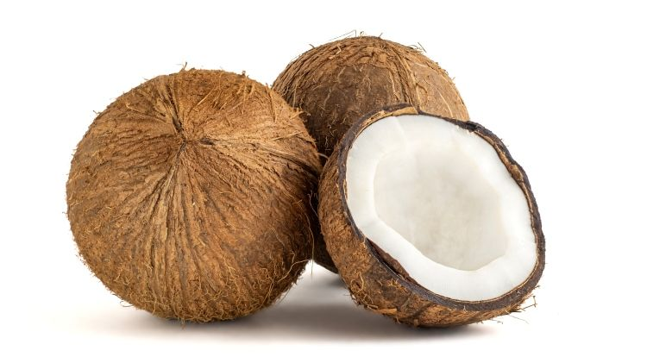
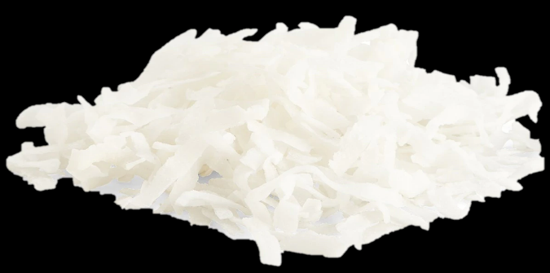


Benefits of consuming
Coconut
Sweet and chewy unsweetened coconut meat
is a whole food source of fat, fiber and antioxidants
to be enjoyed raw or dried.
For more information, visit our website:
www.advancedhealth.com/healthy-bytes-initiative

Slide 2
Benefits of consuming
Coconut
2 Tbsp shredded unsweetened coconut provides:
35 Calories
.5 gm protein
1 gm fiber
3 gm fat
No cholesterol
For more information, visit our website:
www.advancedhealth.com/healthy-bytes-initiative

Slide 3
Benefits of consuming
Coconut
Although high in saturated fat, coconut meat
may help lower LDL cholesterol and raise HDL.
For more information, visit our website:
www.advancedhealth.com/healthy-bytes-initiative

Slide 4
Benefits of consuming
Coconut
82-90% of coconut fat is saturated, made of mostly medium-chain
fatty acids or MCTs. These fats are converted to energy
more easily than animal sources of saturated fat.
For more information, visit our website:
www.advancedhealth.com/healthy-bytes-initiative

Slide 5
Benefits of consuming
Coconut
Coconut meat is high in manganese, essential for bone health.
They also contain potassium for healthy blood pressure, phosphorus for DNA and copper for immunity, energy production and metabolism.
For more information, visit our website:
www.advancedhealth.com/healthy-bytes-initiative

Slide 6
Benefits of consuming
Coconut
Coconut is a fruit that is low in sugar.
It contains multiple antioxidants that fight free radicals
and oxidative stress associated with aging and disease.
For more information, visit our website:
www.advancedhealth.com/healthy-bytes-initiative

Slide 7
Benefits of consuming
Coconut
Use shredded coconut in cereal, stirred into dips or spreads, atop fruit or vegetable salads, making cookies or mixed in smoothies.
For more information, visit our website:
www.advancedhealth.com/healthy-bytes-initiative

Slide 8
Benefits of consuming
Coconut
Coconuts also contribute coconut water,
coconut milk and coconut oil.
For more information, visit our website:
www.advancedhealth.com/healthy-bytes-initiative

