Slide 1
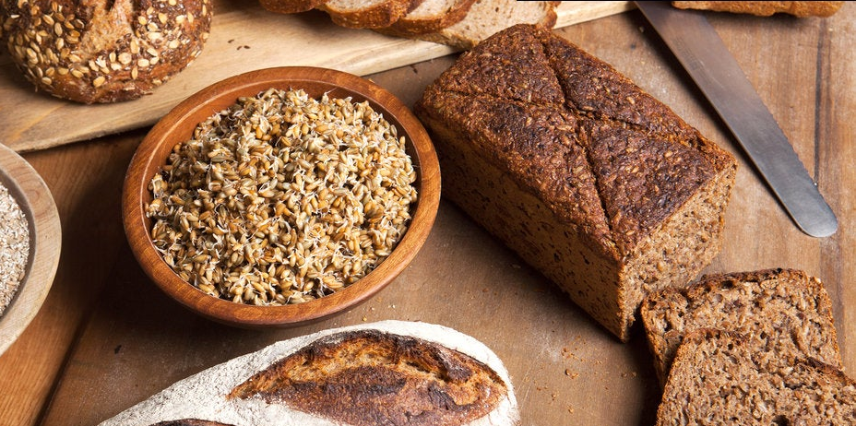
Benefits of consuming
Rye
Rye grains look like wheat grains but are higher in potassium,
vitamin E and fiber. Like wheat, rye grains are cracked before use.
Ground rye flour is slightly darker in color with a rich flavor.
For more information, visit our website:
www.advancedhealth.com/healthy-bytes-initiative

Slide 2
Benefits of consuming
Rye
¼ cup cracked rye grains provides:
143 Calories
4 gm protein
7 gm fiber
1 gm fat
No cholesterol
For more information, visit our website:
www.advancedhealth.com/healthy-bytes-initiative

Slide 3
Benefits of consuming
Rye
Rye is a rich source of B vitamins thiamin, pantothenic acid and folate
and vitamins K and E. Rye is also a good source of manganese,
potassium, copper and phosphorus.
For more information, visit our website:
www.advancedhealth.com/healthy-bytes-initiative

Slide 4
Benefits of consuming
Rye
Rye has a lower glycemic index and more soluble fiber than wheat
making it a better choice for those with diabetes.
Rye also fights inflammation and heart disease.
For more information, visit our website:
www.advancedhealth.com/healthy-bytes-initiative

Slide 5
Benefits of consuming
Rye
Rye is lower in gluten than wheat, creating denser baked goods.
Most commercial rye breads are often made with half rye-half wheat flour.
When seeking 100% rye, read labels carefully.
For more information, visit our website:
www.advancedhealth.com/healthy-bytes-initiative

Slide 6
Benefits of consuming
Rye
Rye is available cut into course groats, rolled or ground into flour.
The darker the flour, the more nutrients are retained.
Rye groats and rolled rye make a tasty and satisfying hot morning cereal.
For more information, visit our website:
www.advancedhealth.com/healthy-bytes-initiative

