Slide 1
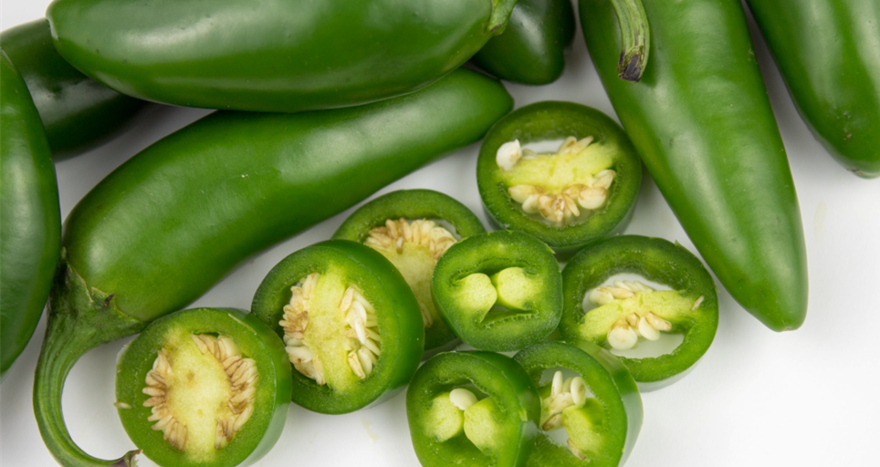


Benefits of consuming
~
Jalapenos
These chili peppers are rich in vitamins
with an added punch of capsaicin that makes the peppers mildly spicy.
They can be picked green or fully ripened red.
For more information, visit our website:
www.advancedhealth.com/healthy-bytes-initiative

Slide 2
Benefits of consuming
~
Jalapenos
~
1 cup chopped raw jalapeno provides:
26 Calories
0.8 gm protein
2.5 gm fiber
No fat
No cholesterol
For more information, visit our website:
www.advancedhealth.com/healthy-bytes-initiative

Slide 3
Benefits of consuming
~
Jalapenos
Rich in antioxidant vitamin C and vitamin B6
which protect the immune system
and guard against bacteria and yeast infection.
For more information, visit our website:
www.advancedhealth.com/healthy-bytes-initiative

Slide 4
Benefits of consuming
~
Jalapenos
Contain the unique compound capsaicin,
which not only give the pepper its spice,
but may help to boost metabolism.
For more information, visit our website:
www.advancedhealth.com/healthy-bytes-initiative

Slide 5
Benefits of consuming
~
Jalapenos
Capsaicin has strong anti-cancer properties,
helps stabilize blood sugars and may help to prevent stomach ulcers.
For more information, visit our website:
www.advancedhealth.com/healthy-bytes-initiative

Slide 6
Benefits of consuming
~
Jalapenos
~
Wear food-safe gloves when chopping jalapenos to prevent
the transfer of spicy compounds to the eyes and other sensitive areas.
Remove seeds to reduce spiciness.
For more information, visit our website:
www.advancedhealth.com/healthy-bytes-initiative

Slide 7
Benefits of consuming
~
Jalapenos
~
Chop raw jalapenos in salad or guacamole, on sandwiches
or mix into chili or veggie stir fry.
Canned jalapenos are an easy addition to soups or baked goods.
~
For more information, visit our website:
www.advancedhealth.com/healthy-bytes-initiative

