Slide 1
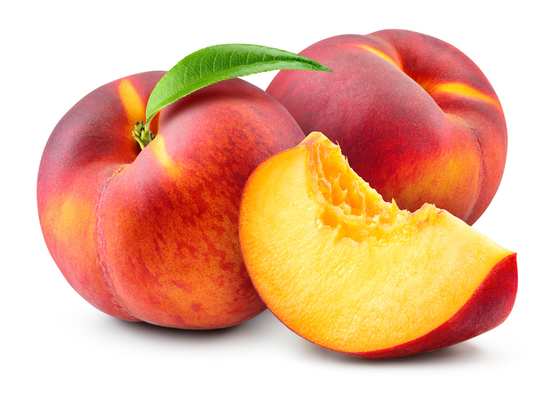


Benefits of consuming
Peaches
This juicy and delicious fruit is packed with
vitamins, minerals, powerful antioxidants and other nutrients
to support good health.
For more information, visit our website:
www.advancedhealth.com/healthy-bytes-initiative

Slide 2
Benefits of consuming
Peaches
1 medium (2⅔” diameter) provides:
58.5 calories
0.4 gm fat
2 .3 gm fiber
1.4 gm protein
no sodium
no cholesterol
For more information, visit our website:
www.advancedhealth.com/healthy-bytes-initiative

Slide 3
Benefits of consuming
Peaches
Peaches are a good source of vitamin C,
which promotes bodily healing and protects cells from free radicals.
For more information, visit our website:
www.advancedhealth.com/healthy-bytes-initiative

Slide 4
Benefits of consuming
Peaches
One medium peach provides approximately
13% of vitamin C, 3% of vitamin A
and 2% or more Daily Value of vitamins E, K and B3 (niacin).
For more information, visit our website:
www.advancedhealth.com/healthy-bytes-initiative

Slide 5
Benefits of consuming
Peaches
Peaches contain potassium which can
lower your risk of
heart disease and stroke by reducing blood pressure.
For more information, visit our website:
www.advancedhealth.com/healthy-bytes-initiative

Slide 6
Benefits of consuming
Peaches
Peaches are also a good source of manganese and copper,
and contain small amounts of magnesium, phosphorus, and iron.
For more information, visit our website:
www.advancedhealth.com/healthy-bytes-initiative

Slide 7
Benefits of consuming
Peaches
One medium peach can provide up to 9% of daily fiber requirements. Peaches provide both soluble and insoluble fiber that can help control blood sugar levels, aid in weight management and reduce constipation.
For more information, visit our website:
www.advancedhealth.com/healthy-bytes-initiative

Slide 8
Benefits of consuming
Peaches
Peaches contain antioxidants like beta-carotene that promote eye,
skin, brain, and lung health, also fights against free radicals
in prevention of some cancers, cognitive disorders and heart disease.
For more information, visit our website:
www.advancedhealth.com/healthy-bytes-initiative

Slide 9
Benefits of consuming
Peaches
Peaches are used fresh, canned, frozen, and dried, as an easy addition to baked goods, smoothies, salads, drinks, and as a topping.
Ripe peaches can be stored in the refrigerator for up to 5 days and kept frozen for up to 6 months for later use.
For more information, visit our website:
www.advancedhealth.com/healthy-bytes-initiative

