Slide 1
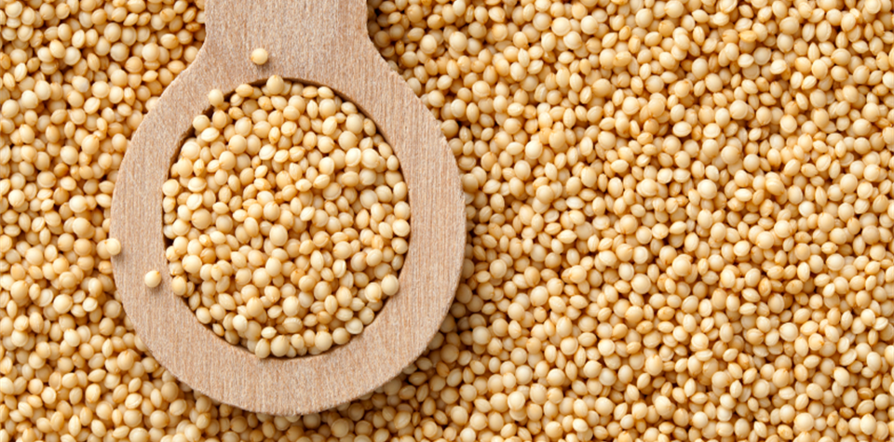
Benefits of consuming
Amaranth
Amaranth is a small ancient grain, slightly larger than a poppy seed
with a range of antioxidants and phytonutrients that fight disease.
Gluten-free with a nutty flavor, it is a good source of protein & dietary fiber.
For more information, visit our website:
www.advancedhealth.com/healthy-bytes-initiative

Slide 2
Benefits of consuming
Amaranth
½ cup cooked amaranth provides:
126 Calories
5 gm protein
3 gm fiber
2 gm fat
No cholesterol
For more information, visit our website:
www.advancedhealth.com/healthy-bytes-initiative

Slide 3
Benefits of consuming
Amaranth
Amaranth is a grain with high-quality protein,
containing all 9 essential amino acids.
For more information, visit our website:
www.advancedhealth.com/healthy-bytes-initiative

Slide 4
Benefits of consuming
Amaranth
This tiny grain is rich in antioxidants and anti-inflammatory compounds
that reduce risk for heart disease, diabetes,
cancer and autoimmune disease.
For more information, visit our website:
www.advancedhealth.com/healthy-bytes-initiative

Slide 5
Benefits of consuming
Amaranth
Amaranth is high in dietary fiber that stimulates bowels,
lowers cholesterol and improve gut health. It has a low glycemic index
making it a good choice for those with diabetes.
For more information, visit our website:
www.advancedhealth.com/healthy-bytes-initiative

Slide 6
Benefits of consuming
Amaranth
Amaranth is high in manganese which helps lower blood sugars
and may prevent kidney disease.
Manganese is also important for healthy bones and immunity.
For more information, visit our website:
www.advancedhealth.com/healthy-bytes-initiative

Slide 7
Benefits of consuming
Amaranth
Amaranth is unique because it not only contains iron
but also has vitamin C which helps us to absorb iron.
For more information, visit our website:
www.advancedhealth.com/healthy-bytes-initiative

Slide 8
Benefits of consuming
Amaranth
Use amaranth as a morning porridge, in soups,
popped in salads or ground into flour for gluten-free baking.
For more information, visit our website:
www.advancedhealth.com/healthy-bytes-initiative

Slide 9
Benefits of consuming
Amaranth
For recipes go to any of these 3 websites
www.advancedhealth.com/healthy-bytes-initiative
www.coosheadfood.coop
https://extension.oregonstate.edu/coos/healthy-families-communities
For more information, visit our website:
www.advancedhealth.com/healthy-bytes-initiative

