Slide 1
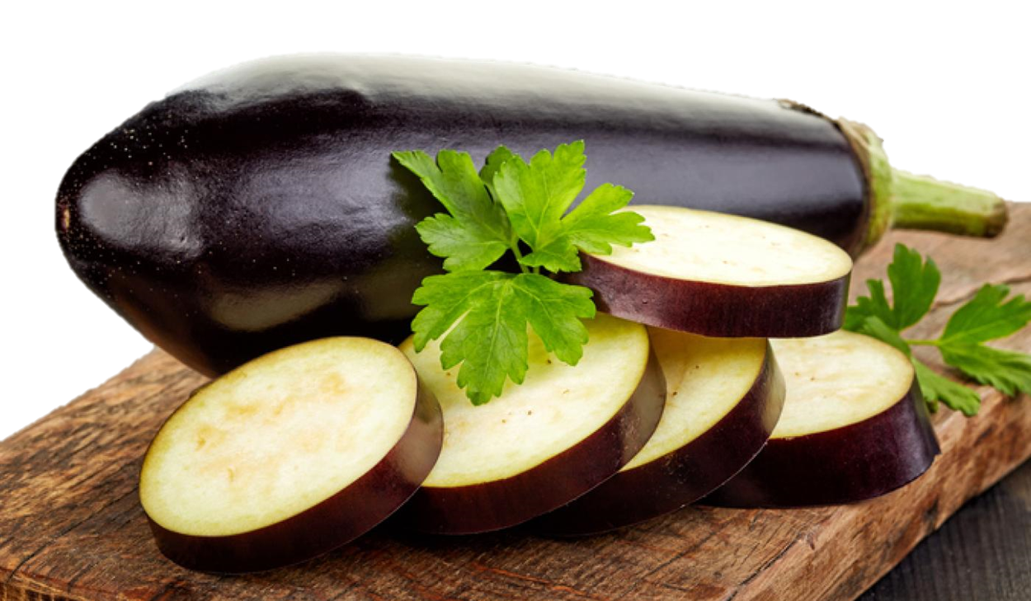
Benefits of consuming
Eggplant
A member of the nightshade family, this deep purple “vegetable” contains powerful disease-fighting compounds making it a great addition to a healthy diet. Eggplant is really a fruit or flowering vegetable.
For more information, visit our website:
www.advancedhealth.com/healthy-bytes-initiative

Slide 2
Benefits of consuming
Eggplant
1 cup raw or ½ cup cooked eggplant provides:
20 Calories
1 gm protein
3 gm fiber
0 gm fat
No cholesterol
For more information, visit our website:
www.advancedhealth.com/healthy-bytes-initiative

Slide 3
Benefits of consuming
Eggplant
Eggplant are an excellent source of antioxidants that protect against heart disease and cancer, particularly due to anthocyanins responsible for the purple color.
For more information, visit our website:
www.advancedhealth.com/healthy-bytes-initiative

Slide 4
Benefits of consuming
Eggplant
Eggplant contains vitamins B, C, E & K, minerals copper, magnesium, potassium and dietary fiber.
For more information, visit our website:
www.advancedhealth.com/healthy-bytes-initiative

Slide 5
Benefits of consuming
Eggplant
Powerful polyphenol antioxidants lower cholesterol, improve heart function and help lower blood sugars.
For more information, visit our website:
www.advancedhealth.com/healthy-bytes-initiative

Slide 6
Benefits of consuming
Eggplant
Solasodine rhamnosyl glycosides (SRGs) found in eggplant skins have potential uses in anticancer therapies, particularly in regard to skin cancer.
For more information, visit our website:
www.advancedhealth.com/healthy-bytes-initiative

Slide 7
Benefits of consuming
Eggplant
Nasunin in eggplant flesh has been found to protect brain cell membranes and neutralize free radicals that can lead to aging, disease and dementia.
For more information, visit our website:
www.advancedhealth.com/healthy-bytes-initiative

Slide 8
Benefits of consuming
Eggplant
Try raw eggplant in salads or puree grilled eggplant for dips or sandwich spreads. Add to stir-fry dishes or substitute for noodles in lasagna. Can even be used in place of pizza dough.
For more information, visit our website:
www.advancedhealth.com/healthy-bytes-initiative

