Slide 1
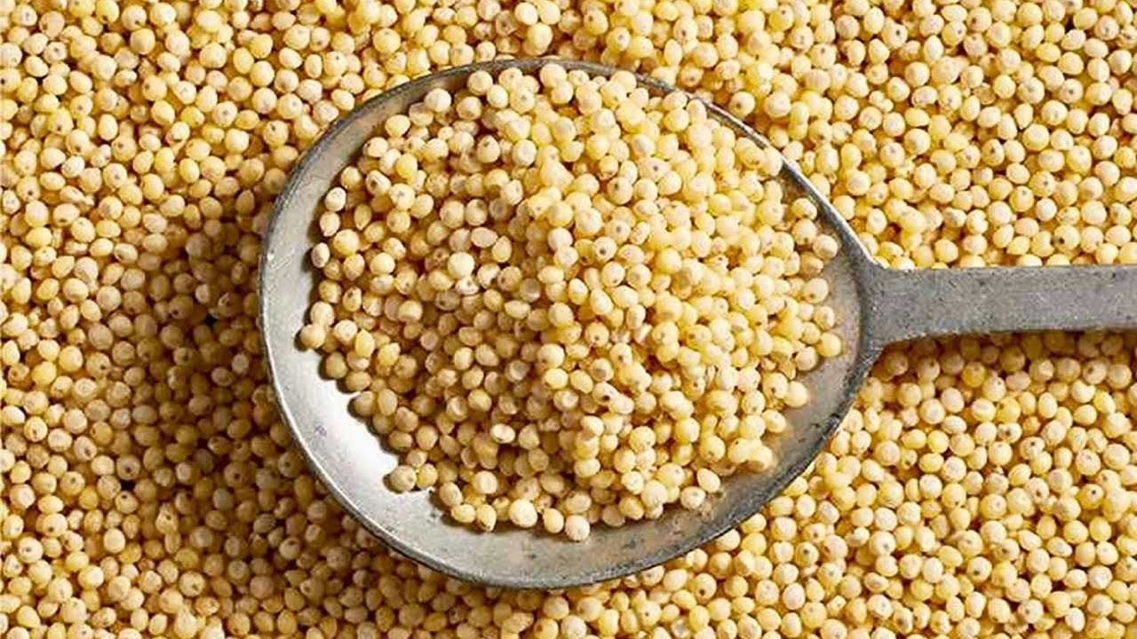
Benefits of consuming
Millet
These tiny round grains, often used in bird seed, are good for humans, too!
They can reduce your risk for heart disease, diabetes and cancer.
For more information, visit our website:
www.advancedhealth.com/healthy-bytes-initiative

Slide 2
Benefits of consuming
Millet
1 cup cooked millet provides:
200 Calories
6 gm protein
2.3 gm fiber
1.7 gm fat
No cholesterol
For more information, visit our website:
www.advancedhealth.com/healthy-bytes-initiative

Slide 3
Benefits of consuming
Millet
1 cup cooked millet provides:
• 200 Calories, 6 gm protein, 2.3 gm fiber, 1.7 gm fat, no cholesterol
Potential benefits of consuming millet:
• Excellent source of antioxidants from vitamins C, E, K & selenium
• High in polyphenol antioxidants which are protective against cancer, diabetes & heart disease
• Rich in fiber, vitamins B6, niacin, riboflavin & folate, and minerals calcium, iron, copper, magnesium & potassium
• Lowers blood pressure, helps the body produce energy, repairs tissues & lowers risk of risk of heart attack & type 2 diabetes
• Naturally gluten free, inexpensive, widely available & easy to cook
• Tastes best if toasted in a dry pan for 3 minutes. Then cook 1 cup millet in 2 cups water for a whole grain side dish, or 1 cup millet in 3 cups water for a creamy porridge. Cooks in 15 minutes
Millet is an excellent source of antioxidants from vitamins
C, E, K & selenium. It is also rich in polyphenol antioxidants,
which offer protection against cancer, diabetes and heart disease.
For more information, visit our website:
www.advancedhealth.com/healthy-bytes-initiative

Slide 4
Benefits of consuming
Millet
Millet is rich in both soluble & insoluble fiber,
vitamins B6, niacin, riboflavin & folate,
and minerals calcium, iron, copper, magnesium & potassium
For more information, visit our website:
www.advancedhealth.com/healthy-bytes-initiative

Slide 5
Benefits of consuming
Millet
Millet is naturally gluten free, inexpensive,
widely available & easy to cook
For more information, visit our website:
www.advancedhealth.com/healthy-bytes-initiative

Slide 6
Benefits of consuming
Millet
Try roasting millet grains in a dry pan for 3 minutes before cooking.
This brings out a rich, nutty flavor.
For more information, visit our website:
www.advancedhealth.com/healthy-bytes-initiative

Slide 7
Benefits of consuming
Millet
Cook 1 cup millet in 2 cups water for a whole grain side dish,
or use 3 cups water per cup of millet for a creamy breakfast porridge.
Cooks in 15 minutes.
For more information, visit our website:
www.advancedhealth.com/healthy-bytes-initiative

