Slide 1
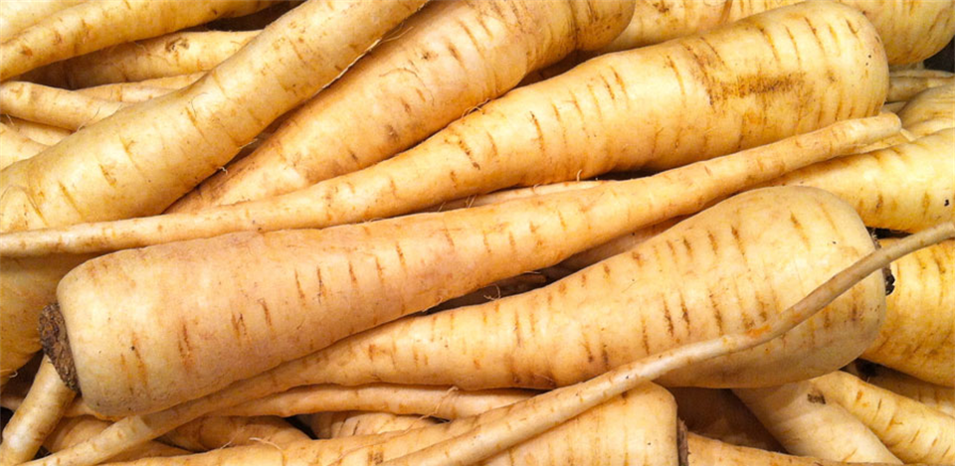


Benefits of consuming
Parsnips
Parsnips are a root vegetable similar in shape and texture to carrots. They are light beige in color and have a sweet, nutty flavor.
For more information, visit our website:
www.advancedhealth.com/healthy-bytes-initiative

Slide 2
Benefits of consuming
Parsnips
1 cup raw parsnips provides:
100 Calories
2 gm protein
7 gm fiber
0 gm fat
No cholesterol
For more information, visit our website:
www.advancedhealth.com/healthy-bytes-initiative

Slide 3
Benefits of consuming
Parsnips
Parsnips provide antioxidants vitamins C, K, and E that boost immunity and protect against disease.
For more information, visit our website:
www.advancedhealth.com/healthy-bytes-initiative

Slide 4
Benefits of consuming
Parsnips
The B vitamin folate in parsnips is important for blood cell formation and healthy growth, especially of the fetus during pregnancy.
For more information, visit our website:
www.advancedhealth.com/healthy-bytes-initiative

Slide 5
Benefits of consuming
Parsnips
Parsnips provide several important minerals.
Magnesium is important for nerve and muscle function, energy production and healthy bones. Phosphorus also plays a role in bones and teeth.
For more information, visit our website:
www.advancedhealth.com/healthy-bytes-initiative

Slide 6
Benefits of consuming
Parsnips
Zinc supports immunity, wound-healing, growth
and the preservation of our sense of taste.
Potassium helps to lower blood pressure.
For more information, visit our website:
www.advancedhealth.com/healthy-bytes-initiative

Slide 7
Benefits of consuming
Parsnips
Parsnips are high in both soluble and insoluble fiber
to improve digestion, lower risk of diabetes and cancer,
feed healthy gut microbes and aid in weight management.
For more information, visit our website:
www.advancedhealth.com/healthy-bytes-initiative

Slide 8
Benefits of consuming
Parsnips
Chop parsnips into soups or stews, or grate for making parsnip “rice.”
Roast or boil, mash like potatoes, peel into long strands to use like pasta, or slice raw for salads, slaws or with veggie dip.
For more information, visit our website:
www.advancedhealth.com/healthy-bytes-initiative

Slide 9
Benefits of consuming
Parsnips
For recipes go to any of these 3 websites
www.advancedhealth.com/healthy-bytes-initiative
www.coosheadfood.coop
https://extension.oregonstate.edu/coos/healthy-families-communities
For more information, visit our website:
www.advancedhealth.com/healthy-bytes-initiative

