Slide 1
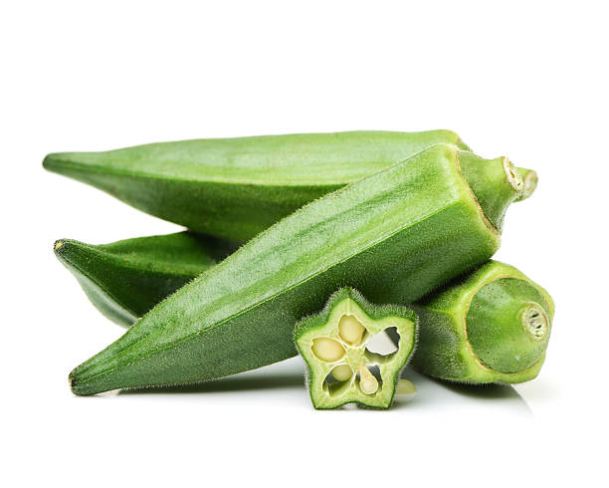


Okra
Sometimes called Lady’s Fingers, okra’s mild flavor
is similar to eggplant or green beans.
It is low in calories, rich in antioxidants and a good source of fiber.
For more information, visit our website:
www.advancedhealth.com/healthy-bytes-initiative

Slide 2
Okra
1 cup raw okra provides:
33 Calories
2 gm protein
3 gm fiber
0 gm fat
No cholesterol
For more information, visit our website:
www.advancedhealth.com/healthy-bytes-initiative

Slide 3
Okra
Okra contains anti-inflammatory antioxidants vitamin C,
beta-carotene, oxalic acid, catechins, quercetin and flavonoids
which fight chronic disease and aging.
For more information, visit our website:
www.advancedhealth.com/healthy-bytes-initiative

Slide 4
Okra
B vitamin folate in okra helps to prevent birth defects,
supports DNA and fights breast cancer risk.
For more information, visit our website:
www.advancedhealth.com/healthy-bytes-initiative

Slide 5
Okra
Okra contains minerals iron, calcium, magnesium and potassium
which contribute to bone, heart and blood pressure health.
For more information, visit our website:
www.advancedhealth.com/healthy-bytes-initiative

Slide 6
Okra
Okra is high in soluble fiber which controls blood sugars,
lowers cholesterol and feeds our healthy gut microbiome.
For more information, visit our website:
www.advancedhealth.com/healthy-bytes-initiative

Slide 7
Okra
Lectin, a type of protein found in okra,
may help reduce the growth of cancer cells.
For more information, visit our website:
www.advancedhealth.com/healthy-bytes-initiative

Slide 8
Okra
Okra can be consumed raw, roasted, boiled, sautéed, fried or steamed.
Toss in salads, salsa, soups, stews or use as side dish.
For more information, visit our website:
www.advancedhealth.com/healthy-bytes-initiative

Slide 9

Okra
For recipes, visit any of these 3 websites
www.advancedhealth.com/healthy-bytes-initiative
www.coosheadfood.coop/join-us
https://extension.oregonstate.edu/coos/healthy-families-communities
For more information, visit our website:
www.advancedhealth.com/healthy-bytes-initiative

