Slide 1
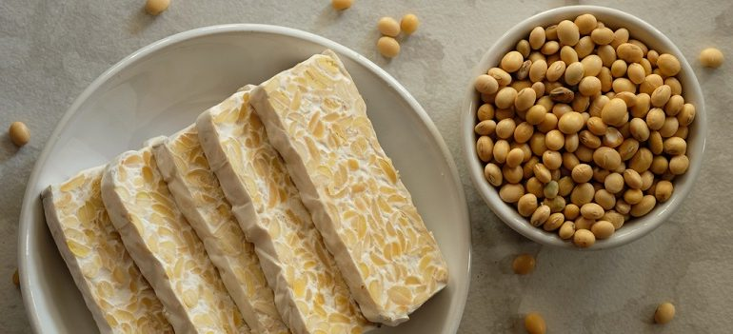
Tempeh
Tempeh is made from soybeans that have been fermented and pressed
into a firm, chewy loaf. It contains live probiotics to support gut health
and is an inexpensive, healthy alternative to meat.
For more information, visit our website:
www.advancedhealth.com/healthy-bytes-initiative

Slide 2
Tempeh
1 3 ounce portion of tempeh provides:
162 Calories
18 gm protein
7 gm fiber
5 gm fat
No cholesterol
For more information, visit our website:
www.advancedhealth.com/healthy-bytes-initiative

Slide 3
Tempeh
Tempeh is high in protein and fiber, low fat,
with all 9 essential amino acids making it a healthy meat substitute.
For more information, visit our website:
www.advancedhealth.com/healthy-bytes-initiative

Slide 4
Tempeh
Fermentation of tempeh provides probiotics (healthy bacteria)
and high fiber (prebiotics) feeds our healthy microbiome.
For more information, visit our website:
www.advancedhealth.com/healthy-bytes-initiative

Slide 5
Tempeh
Tempeh provides vitamins niacin, riboflavin and B12
and calcium for bones, potassium for healthy blood pressure,
magnesium for heart health and iron for oxygen transport.
For more information, visit our website:
www.advancedhealth.com/healthy-bytes-initiative

Slide 6
Tempeh
Isoflavones in soy products like tempeh
have antioxidants and anti-cancer properties.
For more information, visit our website:
www.advancedhealth.com/healthy-bytes-initiative

Slide 7
Tempeh
Tempeh is typically marinated or seasoned, then crumbled,
baked, steamed or sautéed. Use in stir fry, salads or on sandwiches.
For more information, visit our website:
www.advancedhealth.com/healthy-bytes-initiative

Slide 8
Tempeh
For recipes, visit any of these 3 websites
www.advancedhealth.com/healthy-bytes-initiative
www.coosheadfood.coop/join-us
https://extension.oregonstate.edu/coos/healthy-families-communities
For more information, visit our website:
www.advancedhealth.com/healthy-bytes-initiative

