Slide 1
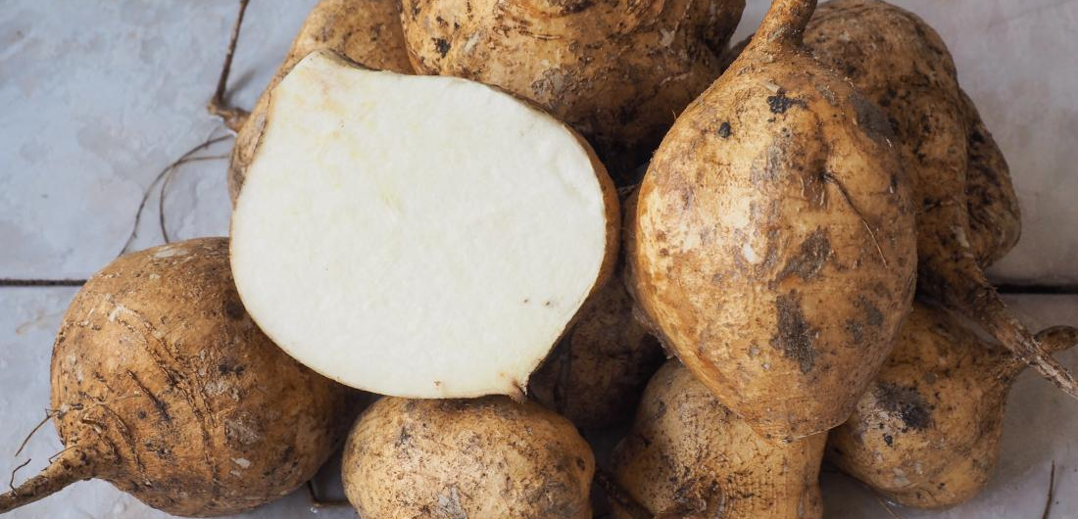


Jicama
Jicama (Hik-a-ma) is a Latin American vegetable is rich in prebiotics, fiber,
nutrients and water. Its slightly sweet, slightly nutty flavor makes it a unique
stand-alone snack or suited for an additional ingredient in a variety of dishes.
For more information, visit our website:
www.advancedhealth.com/healthy-bytes-initiative

Slide 2
Jicama
1 cup fresh jicama provides:
49 Calories
1 gm protein
6.4 gm fiber
No fat
No cholesterol
For more information, visit our website:
www.advancedhealth.com/healthy-bytes-initiative

Slide 3
Jicama
Jicama is high in vitamin C, a powerful antioxidant
that promotes healing, and maintains healthy skin, bones, and cartilage.
For more information, visit our website:
www.advancedhealth.com/healthy-bytes-initiative

Slide 4
Jicama
Jicama contains vitamin B6, important for healthy metabolism and mood regulation.
For more information, visit our website:
www.advancedhealth.com/healthy-bytes-initiative

Slide 5
Jicama
Potassium in jicama maintains fluid levels, aids in muscle contractions, and promotes healthy blood pressure.
For more information, visit our website:
www.advancedhealth.com/healthy-bytes-initiative

Slide 6
Jicama
Jicama is a significant source of iron, needed for growth, development, and the creation of blood proteins responsible for delivering oxygen in the body.
For more information, visit our website:
www.advancedhealth.com/healthy-bytes-initiative

Slide 7
Jicama
Jicama is also a source of the prebiotic fiber, inulin, which may help with weight loss, boost mood and lower the risk of certain chronic diseases.
For more information, visit our website:
www.advancedhealth.com/healthy-bytes-initiative

Slide 8
Jicama
Jicama is traditionally eaten raw, peeled and sliced into strips, usually with lemon or lime juice and seasoned with chili powder.
For more information, visit our website:
www.advancedhealth.com/healthy-bytes-initiative

Slide 9
Jicama
Jicama can also be sliced thin and added to sandwiches or to replace the tortilla in tacos. Cube and toss in salads for a crunch.
For more information, visit our website:
www.advancedhealth.com/healthy-bytes-initiative

Slide 10
Jicama
Since jicama is porous, it picks up flavors easily. It can be marinated and added to recipes such as stir fry sauté over low heat until barely tender.
For more information, visit our website:
www.advancedhealth.com/healthy-bytes-initiative

Slide 11

Jicama
For recipes, visit any of these 3 websites
www.advancedhealth.com/healthy-bytes-initiative
www.coosheadfood.coop/join-us
https://extension.oregonstate.edu/coos/healthy-families-communities
For more information, visit our website:
www.advancedhealth.com/healthy-bytes-initiative

