Slide 1
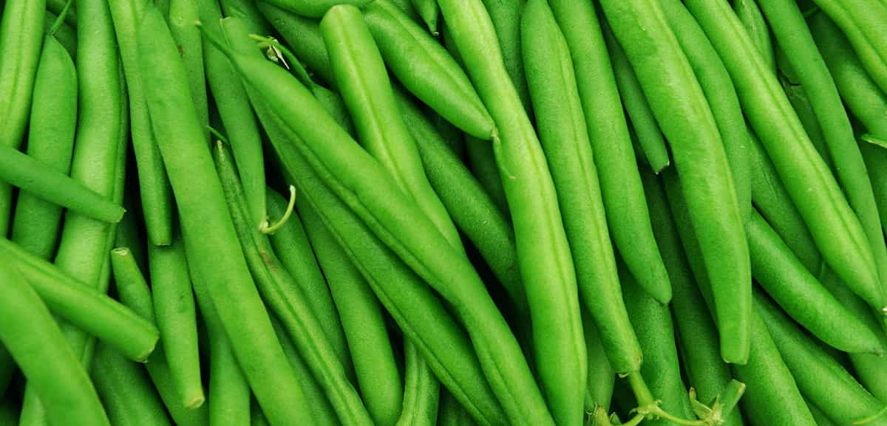
Green Beans
A common holiday favorite, green beans are rich in antioxidants,
fiber and even protein. But health benefits can be reduced
by mixing with unhealthy added ingredients.
For more information, visit our website:
www.advancedhealth.com/healthy-bytes-initiative

Slide 2
Green Beans
1 cup raw or ½ cup cooked green beans provides:
31 Calories
2 gm protein
3 gm fiber
No fat
No cholesterol
For more information, visit our website:
www.advancedhealth.com/healthy-bytes-initiative

Slide 3
Green Beans
Green beans are an excellent source of antioxidants vitamins C,
K and beta-carotene and a good source of B vitamins
folate, riboflavin and thiamin.
For more information, visit our website:
www.advancedhealth.com/healthy-bytes-initiative

Slide 4
Green Beans
Green beans are high in potassium and low in sodium
for healthy blood pressure.
Be advised that canned beans can be higher in sodium.
For more information, visit our website:
www.advancedhealth.com/healthy-bytes-initiative

Slide 5
Green Beans
Minerals in green beans include manganese which supports bone health, and magnesium, required for nerve transmissions, energy production
and muscle contraction including maintaining heart rhythm.
For more information, visit our website:
www.advancedhealth.com/healthy-bytes-initiative

Slide 6
Green Beans
Green beans contain both soluble and insoluble fiber
for healthy blood sugars,
lowering cholesterol and maintaining digestive health.
For more information, visit our website:
www.advancedhealth.com/healthy-bytes-initiative

Slide 7
Green Beans
Use fresh beans in salads or serve with dips.
Toss into soups or stews.
For more information, visit our website:
www.advancedhealth.com/healthy-bytes-initiative

Slide 8
Green Beans
Beans can be cooked in a variety of ways.
Boil, steam, microwave, roast and toss with garlic
for a healthy alternative to Thanksgiving green bean casserole.
For more information, visit our website:
www.advancedhealth.com/healthy-bytes-initiative

Slide 9
Green Beans
.
For recipes, visit any of these 3 websites
www.advancedhealth.com/healthy-bytes-initiative
www.coosheadfood.coop/join-us
https://extension.oregonstate.edu/coos/healthy-families-communities
For more information, visit our website:
www.advancedhealth.com/healthy-bytes-initiative

