Slide 1
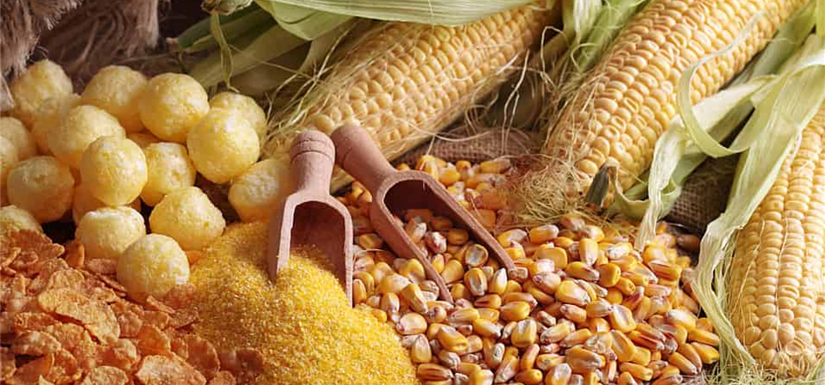


Maize/Corn
Maize is a category of grain that includes sweet corn, popcorn, baby corn and Indian corn of different colors. A staple of African, meso and Native American indigenous cultures, it is a symbol of spiritual and economic stability.
For more information, visit our website:
www.advancedhealth.com/healthy-bytes-initiative

Slide 2
Maize/Corn
1/2 cup cooked maize/corn provides:
98 Calories
3 gm protein
2 gm fiber
<1 gm fat
No cholesterol
For more information, visit our website:
www.advancedhealth.com/healthy-bytes-initiative

Slide 3
Maize/Corn
Maize/corn is an excellent source of antioxidants vitamin A, lutein and zeaxanthin which promote healthy vision and fight infections.
For more information, visit our website:
www.advancedhealth.com/healthy-bytes-initiative

Slide 4
Maize/Corn
Maize/corn is high in insoluble fiber which aids in
reducing constipation, hemorrhoids and risk of colorectal cancer.
For more information, visit our website:
www.advancedhealth.com/healthy-bytes-initiative

Slide 5
Maize/Corn
Maize/corn contains phytosterols and CoQ10
which help lower cholesterol and risk of heart damage.
For more information, visit our website:
www.advancedhealth.com/healthy-bytes-initiative

Slide 6
Maize/Corn
Purple and blue varieties of maize/corn contain anthocyanins,
an antioxidant that lowers blood pressure
and risk of heart disease and cancer.
For more information, visit our website:
www.advancedhealth.com/healthy-bytes-initiative

Slide 7
Maize/Corn
Maize/corn also contains minerals potassium for healthy blood pressure, magnesium for heart health and calcium for strong bones.
For more information, visit our website:
www.advancedhealth.com/healthy-bytes-initiative

Slide 8
Maize/Corn
Maize/corn can be consumed on the cob, ground into flour or meal,
or treated with lime to make masa for making tortillas or tamales.
For more information, visit our website:
www.advancedhealth.com/healthy-bytes-initiative

Slide 9

Maize/Corn
.
For recipes, visit any of these 3 websites
www.advancedhealth.com/healthy-bytes-initiative
www.coosheadfood.coop/join-us
https://extension.oregonstate.edu/coos/healthy-families-communities
For more information, visit our website:
www.advancedhealth.com/healthy-bytes-initiative

