Slide 1
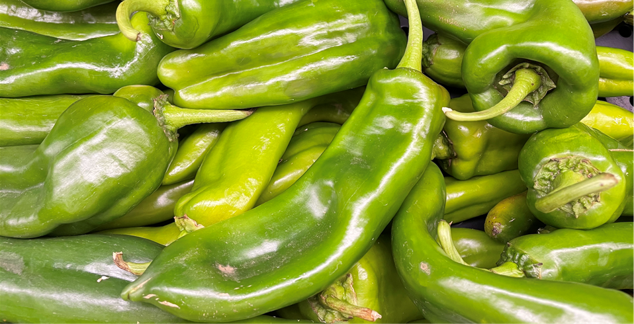



Green Chilis
Green chilis or chiles, are mildly-spicy peppers
that are rich in antioxidants. The spicy aroma is capsaicin,
a compound know for its medicinal properties.
For more information, visit these websites:
www.advancedhealth.com/healthy-bytes-initiative
https://extension.oregonstate.edu/coos/healthy-families-communities

Slide 2
Green Chilis
1/2 cup raw green chilis provides:
30 Calories
1.5 gm protein
1 gm fiber
No fat
No cholesterol
For more information, visit these websites:
www.advancedhealth.com/healthy-bytes-initiative
https://extension.oregonstate.edu/coos/healthy-families-communities

Slide 3
Green Chilis
Green chilis are an excellent source of antioxidants vitamin C and
beta-carotene that neutralize free radicals,
boost immunity and fight inflammation.
For more information, visit these websites:
www.advancedhealth.com/healthy-bytes-initiative
https://extension.oregonstate.edu/coos/healthy-families-communities

Slide 4
Green Chilis
Capsaicin in green chilis has been shown to be toxic to cancer cells
including breast, prostate, colorectal, lung,
prostate and pancreatic cancer.
For more information, visit these websites:
www.advancedhealth.com/healthy-bytes-initiative
https://extension.oregonstate.edu/coos/healthy-families-communities

Slide 5
Green Chilis
Green chilis contain additional antioxidants
lutein and zeaxanthin for eye health.
For more information, visit these websites:
www.advancedhealth.com/healthy-bytes-initiative
https://extension.oregonstate.edu/coos/healthy-families-communities

Slide 6
Green Chilis
Green chilis are a good source of potassium
for healthy blood pressure.
For more information, visit these websites:
www.advancedhealth.com/healthy-bytes-initiative
https://extension.oregonstate.edu/coos/healthy-families-communities

Slide 7
Green Chilis
Green chilis provide calcium, magnesium, zinc, copper and selenium
which all contribute to healthy bone density.
For more information, visit these websites:
www.advancedhealth.com/healthy-bytes-initiative
https://extension.oregonstate.edu/coos/healthy-families-communities

Slide 8
Green Chilis
Capsaicin can be irritating to mucous membranes.
Avoid touching eyes when chopping chilis,
or use food-safe gloves when preparing.
For more information, visit these websites:
www.advancedhealth.com/healthy-bytes-initiative
https://extension.oregonstate.edu/coos/healthy-families-communities

Slide 9
Green Chilis
Add raw or cooked chilis to fresh greens, potato or macaroni salads,
in hummus or sliced on sandwiches.
Toss in soups, stews chili or marinara sauce.
For more information, visit these websites:
www.advancedhealth.com/healthy-bytes-initiative
https://extension.oregonstate.edu/coos/healthy-families-communities

Slide 10
Green Chilis
Green chilis can also be used to make pickles,
salsa or jelly.
For more information, visit these websites:
www.advancedhealth.com/healthy-bytes-initiative
https://extension.oregonstate.edu/coos/healthy-families-communities

Slide 11



Green Chilis
For recipes, visit any of these 3 websites
www.advancedhealth.com/healthy-bytes-initiative
www.coosheadfood.coop/join-us
https://extension.oregonstate.edu/coos/healthy-families-communities

