Slide 1
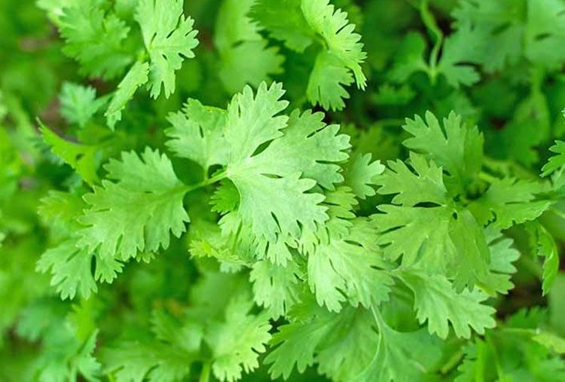



Cilantro
Also known as coriander, cilantro is both an herb and a spice
with antioxidant and anti-inflammatory properties
which can also help lower high cholesterol and blood pressure.
For more information, visit these websites:
www.advancedhealth.com/healthy-bytes-initiative
https://extension.oregonstate.edu/coos/healthy-families-communities

Slide 2
Cilantro
1 cup raw cilantro provides:
16 Calories
<1 gm protein
<1 gm fiber
No fat
No cholesterol
For more information, visit these websites:
www.advancedhealth.com/healthy-bytes-initiative
https://extension.oregonstate.edu/coos/healthy-families-communities

Slide 3
Cilantro
Fresh cilantro leaves are rich in folate for DNA and RNA,
protein metabolism and regulating homocysteine for heart health.
For more information, visit these websites:
www.advancedhealth.com/healthy-bytes-initiative
https://extension.oregonstate.edu/coos/healthy-families-communities

Slide 4
Cilantro
Cilantro greens are a good source of vitamin K which is important for blood clotting and bone health.
For more information, visit these websites:
www.advancedhealth.com/healthy-bytes-initiative
https://extension.oregonstate.edu/coos/healthy-families-communities

Slide 5
Cilantro
Cilantro contains antioxidants vitamin C and beta-carotene
important for wound-healing and neutralizing damaging free radicals.
Other antioxidants include lutein and zeaxanthin for eye health.
For more information, visit these websites:
www.advancedhealth.com/healthy-bytes-initiative
https://extension.oregonstate.edu/coos/healthy-families-communities

Slide 6
Cilantro
Potassium in fresh cilantro helps to regulate fluid balance
and maintain a healthy blood pressure.
For more information, visit these websites:
www.advancedhealth.com/healthy-bytes-initiative
https://extension.oregonstate.edu/coos/healthy-families-communities

Slide 7
Cilantro
Both leaves and stems of cilantro can be used to make pesto
or as a garnish on cooked foods such as tacos and burritos.
For more information, visit these websites:
www.advancedhealth.com/healthy-bytes-initiative
https://extension.oregonstate.edu/coos/healthy-families-communities

Slide 8
Cilantro
Coriander seeds are great for spicing soups and stews
and often used as a pickling spice.
For more information, visit these websites:
www.advancedhealth.com/healthy-bytes-initiative
https://extension.oregonstate.edu/coos/healthy-families-communities

Slide 9
Cilantro
Add raw cilantro to fresh greens, potato or macaroni salads,
in hummus, salsa or guacamole.
For more information, visit these websites:
www.advancedhealth.com/healthy-bytes-initiative
https://extension.oregonstate.edu/coos/healthy-families-communities

Slide 10



Cilantro
For recipes, visit any of these 3 websites
www.advancedhealth.com/healthy-bytes-initiative
www.coosheadfood.coop/join-us
https://extension.oregonstate.edu/coos/healthy-families-communities

