Slide 1
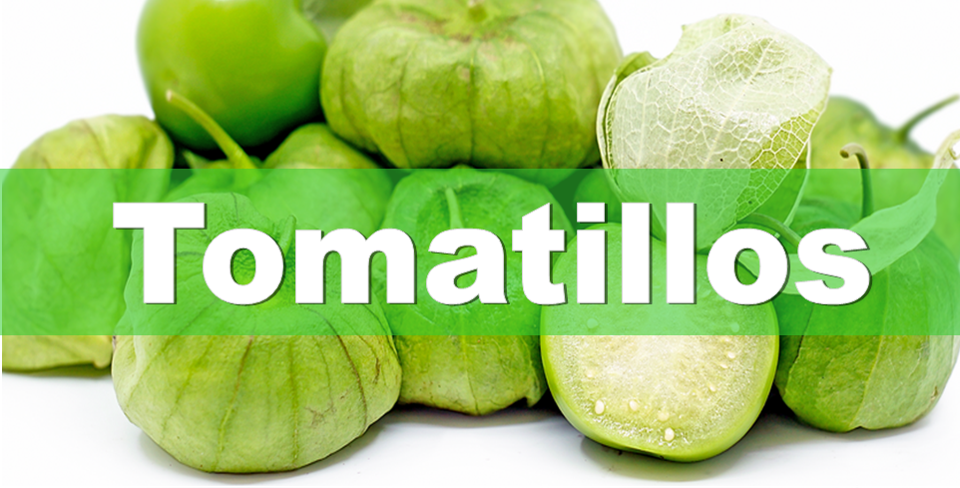
Also known as husk tomatoes, tomatillos are a food staple
in Mexican cultures. They have a light husk that falls away when ripe,
and they remail bright green and firm.
For more information, visit these websites:
www.advancedhealth.com/healthy-bytes-initiative
https://extension.oregonstate.edu/coos/healthy-families-communities

Slide 2
1/2 cup raw tomatillos provides:
32 Calories
<1 gm protein
1 gm fiber
1 gm fat
No cholesterol
For more information, visit these websites:
www.advancedhealth.com/healthy-bytes-initiative
https://extension.oregonstate.edu/coos/healthy-families-communities

Slide 3
Tomatillos provide antioxidants vitamin C and beta-carotene
to boost immunity and reduce risk of cancer.
Lutein and zeaxanthin help to maintain eye health.
For more information, visit these websites:
www.advancedhealth.com/healthy-bytes-initiative
https://extension.oregonstate.edu/coos/healthy-families-communities

Slide 4
Tomatillos contain B vitamins Folate and B6 for metabolism,
and vitamin K for healthy blood clotting.
For more information, visit these websites:
www.advancedhealth.com/healthy-bytes-initiative
https://extension.oregonstate.edu/coos/healthy-families-communities

Slide 5
Anti-tumor compounds called withanolides are known to be
toxic to cancer cells. Withanolides have also been used in the
treatment of inflammation, diabetes and Alzheimer’s.
For more information, visit these websites:
www.advancedhealth.com/healthy-bytes-initiative
https://extension.oregonstate.edu/coos/healthy-families-communities

Slide 6
Minerals in tomatillos include potassium, magnesium, phosphorus
and calcium for healthy blood pressure and bones.
For more information, visit these websites:
www.advancedhealth.com/healthy-bytes-initiative
https://extension.oregonstate.edu/coos/healthy-families-communities

Slide 7
Although tomatillos may look like tomatoes,
they have a distinct citrus flavor and firm texture.
For more information, visit these websites:
www.advancedhealth.com/healthy-bytes-initiative
https://extension.oregonstate.edu/coos/healthy-families-communities

Slide 8
Remove husk and wash before using.
Toss in soups or stews, in salads or salsas, or sliced on sandwiches.
Tomatillos can also be used to make jams and jellies.
For more information, visit these websites:
www.advancedhealth.com/healthy-bytes-initiative
https://extension.oregonstate.edu/coos/healthy-families-communities

Slide 9
For recipes, visit any of these 3 websites
www.advancedhealth.com/healthy-bytes-initiative
www.coosheadfood.coop/join-us
https://extension.oregonstate.edu/coos/healthy-families-communities

