Slide 1
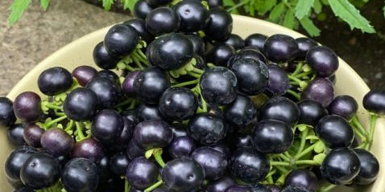



Huckleberries
These dark berries are found along roadsides
and forests in the Pacific Northwest.
They are rich in history as well as nutrients.

Slide 2
Huckleberries
1/2 cup fresh huckleberries provides:
37 Calories
<1 gm protein
2 gm fiber
No fat
No cholesterol

Slide 3
Huckleberries
Huckleberries are rich in antioxidants vitamin C,
polyphenols and cyanidins
that fight inflammation and boost immunity and healing.

Slide 4
Huckleberries
The high anthocyanin content in huckleberries may help
slow or stop growth of cancer cells.

Slide 5
Huckleberries
Huckleberries provide potassium for healthy blood pressure,
iron for oxygen transport
and calcium for bone and heart health.

Slide 6
Huckleberries
Fiber in huckleberries helps lower blood sugars,
improve cholesterol and aid in weight management.

Slide 7
Huckleberries
Huckleberries also provide small amounts of B vitamins
thiamin, riboflavin, niacin and beta-carotene.

Slide 8
Huckleberries
Use huckleberries fresh on salads or oatmeal. Puree for salad dressing or vinaigrette. Toss in pancakes or baked goods.
Cook for making jams, jellies, preserves or huckleberry syrup.

Slide 9
Huckleberries
The leaves of the huckleberry bush can be dried
and brewed to make a tea high in antioxidants.

Slide 10

Huckleberries
For recipes, visit any of these 3 websites
www.advancedhealth.com/healthy-bytes-initiative
www.coosheadfood.coop/join-us
https://extension.oregonstate.edu/coos/healthy-families-communities

