Slide 1
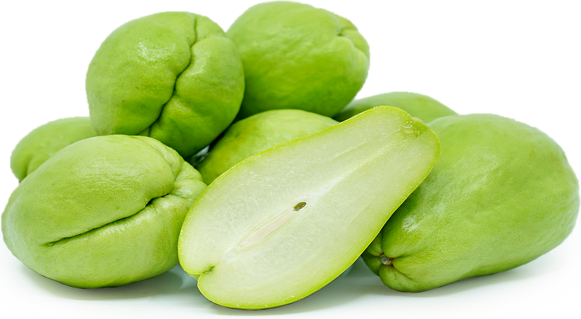
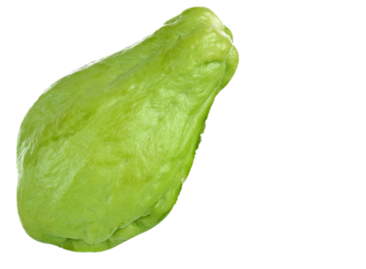



Chayote
This fruit in the squash family has the mildness of zucchini
with the crunch of a cucumber.
All parts are edible including the skin and seed.

Slide 2
Chayote
1 cup raw chayote provides:
25 Calories
1 gm protein
2 gm fiber
No fat
No cholesterol

Slide 3
Chayote
Chayote is an excellent source of antioxidants including vitamin C and quercetin that fight inflammation and boost immunity and healing.

Slide 4
Chayote
Chayote is high in folate, a B vitamin which prevents birth defects, regulates DNA and homocysteine, and reduces risk of heart disease.

Slide 5
Chayote
Chayote is a good source of manganese and vitamin K which are important for healthy bone formation, blood clotting and blood sugar regulation.

Slide 6
Chayote
Chayote is rich in potassium and low in sodium, a healthy combination for keeping blood pressure in check.

Slide 7
Chayote
Fiber in chayote, especially soluble fiber, lowers blood sugars
and cholesterol, aids in weight management
and supports a healthy microbiome.

Slide 8
Chayote
Chayote can be used as a fruit or a vegetable, raw or cooked.
Use raw in salad, slaw, salsa or on sandwiches.
Boil, sauté steam, roast, or BBQ, or toss in soups, stews or casseroles.

Slide 9

Chayote
For recipes, visit any of these 3 websites
www.advancedhealth.com/healthy-bytes-initiative
www.coosheadfood.coop/join-us
https://extension.oregonstate.edu/coos/healthy-families-communities

