Slide 1
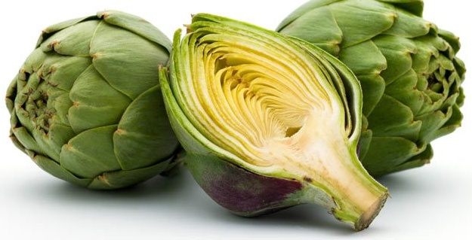
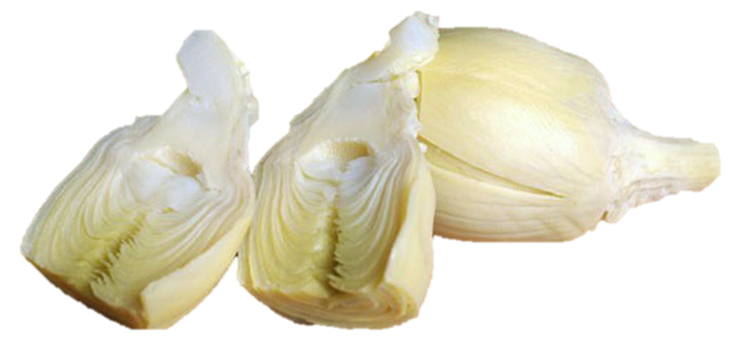



Artichokes
Artichokes are green vegetables rich in protein and fiber
with many health benefits.
Fresh artichokes are usually steamed and hearts can be canned or frozen.

Slide 2
Artichokes
1 medium steamed artichoke provides:
60 Calories
4 gm protein
7 gm fiber
No fat
No cholesterol

Slide 3
Artichokes
Fresh artichokes are an excellent source of vitamin C
important for collagen production, lowering inflammation,
boosting immunity and healing.

Slide 4
Artichokes
Artichokes are a good source of folate, which prevents birth defects, regulates DNA and homocysteine, and reduces risk of heart disease.

Slide 5
Artichokes
Potassium in artichokes helps maintain healthy blood pressure.
Vitamin K is important for blood clotting and blood sugar regulation.

Slide 6
Artichokes
Magnesium and manganese in artichokes
support heart and bone health.

Slide 7
Artichokes
Inulin is a type of soluble fiber that helps lower blood sugars
and cholesterol, aids in weight management
and supports a healthy microbiome.

Slide 8
Artichokes
Steam fresh artichokes and enjoy the leaves with dip.
Use canned or frozen artichoke hearts in salad, soup, dips
or as a pizza topping.

Slide 9

Artichokes
For recipes, visit any of these 3 websites
www.advancedhealth.com/healthy-bytes-initiative
www.coosheadfood.coop/join-us
https://extension.oregonstate.edu/coos/healthy-families-communities

