Slide 1
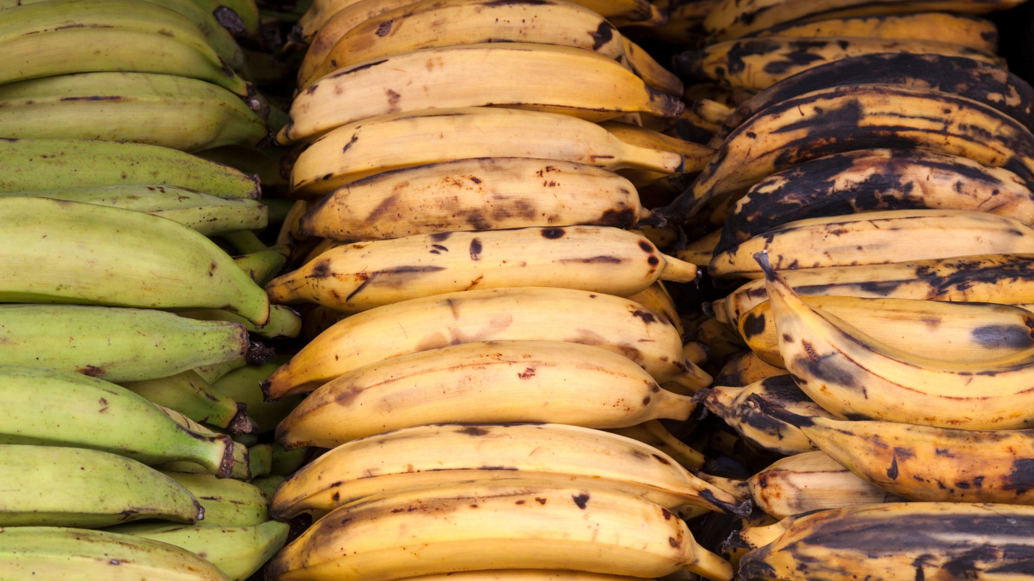
Plantains
Plantains are tropical fruit that look like bananas but are very different
in flavor, texture and size. Plantains are larger, less sweet
and more starchy, similar to a potato, with plenty of health benefits.

Slide 2
Plantains
1 cup cooked plantain provides:
215 Calories
2 gm protein
3 gm fiber
No fat
No cholesterol

Slide 3
Plantains
Plantains are an excellent source of vitamin C
important for collagen production, lowering inflammation,
boosting immunity and healing.

Slide 4
Plantains
Plantains contain more antioxidants including alpha and beta-carotene, lutein and zeaxanthin which support eye health.

Slide 5
Plantains
Plantains are a good source of folate, which prevents birth defects,
regulates DNA and homocysteine, and reduces risk of heart disease.

Slide 6
Plantains
Plantains are high in potassium and low in sodium,
which helps maintain healthy blood pressure.
They also provide choline for brain development, mood and memory.

Slide 7
Plantains
Plantains are rich in resistant starch, a type of fiber,
that lowers blood sugars and cholesterol, aids in weight management
and supports a healthy microbiome.

Slide 8
Plantains
Although plantains can be eaten raw,
they are usually baked, boiled, fried or roasted.

Slide 9
Plantains
Use in place of potatoes in soups, slice for sandwiches
or enjoy baked chips with dip, hummus or guacamole.

Slide 10
Plantains
For recipes, visit any of these websites
www.advancedhealth.com/healthy-bytes-initiative
https://extension.oregonstate.edu/coos/healthy-families-communities

