Slide 1
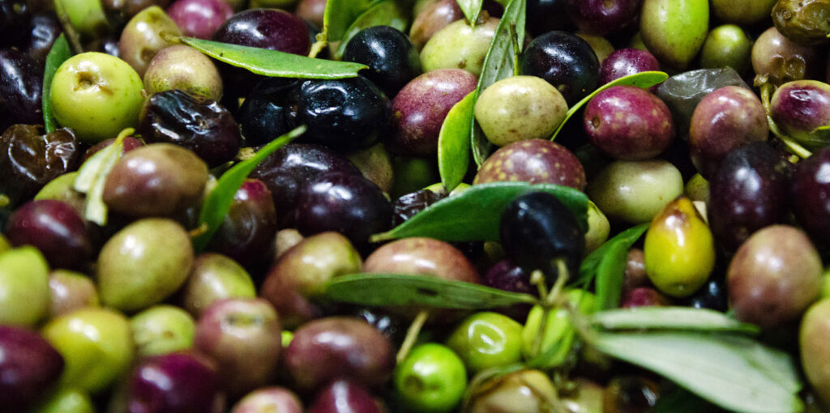
Olives
Olives are fruits rich in healthy fats, antioxidants and fiber.
Nutrition is similar for green, black, or Kalamata varieties.
Most olives are fermented and brined making them high in salt.

Slide 2
Olives
1/4 cup whole olives (about 8) provides:
49 Calories
<½ gm protein
1 gm fiber
6 gm fat
No cholesterol

Slide 3
Olives
Monounsaturated fats in olives can
lower cholesterol and blood pressure.
Black olives have more healthy fat than green olives.

Slide 4
Olives
Olives are rich in antioxidants vitamins A, E and K, polyphenols and
quercetin that protect against inflammation, aging and chronic diseases. Greek olives are highest in these compounds.

Slide 5
Olives
Olives provide calcium for bone health and phosphorus for energy production. They also provide trace amounts of iron and copper.

Slide 6
Olives
Due to processing, all varieties are high in sodium.
Rinsing olives can help lower salt.

Slide 7
Olives
Olives with intact pits are slightly more nutritious
than those with pits removed during processing.
Be sure to remove pits before consuming.

Slide 8
Olives
Use olives in moderation as snack, appetizer or recipe ingredient. Use as appetizer or snack or add to salads or baked goods.
Tampenade is an olive spread for sandwiches or crackers.

Slide 9
Olives
For recipes, visit any of these websites
www.advancedhealth.com/healthy-bytes-initiative
https://extension.oregonstate.edu/coos/healthy-families-communities

